Slide 1
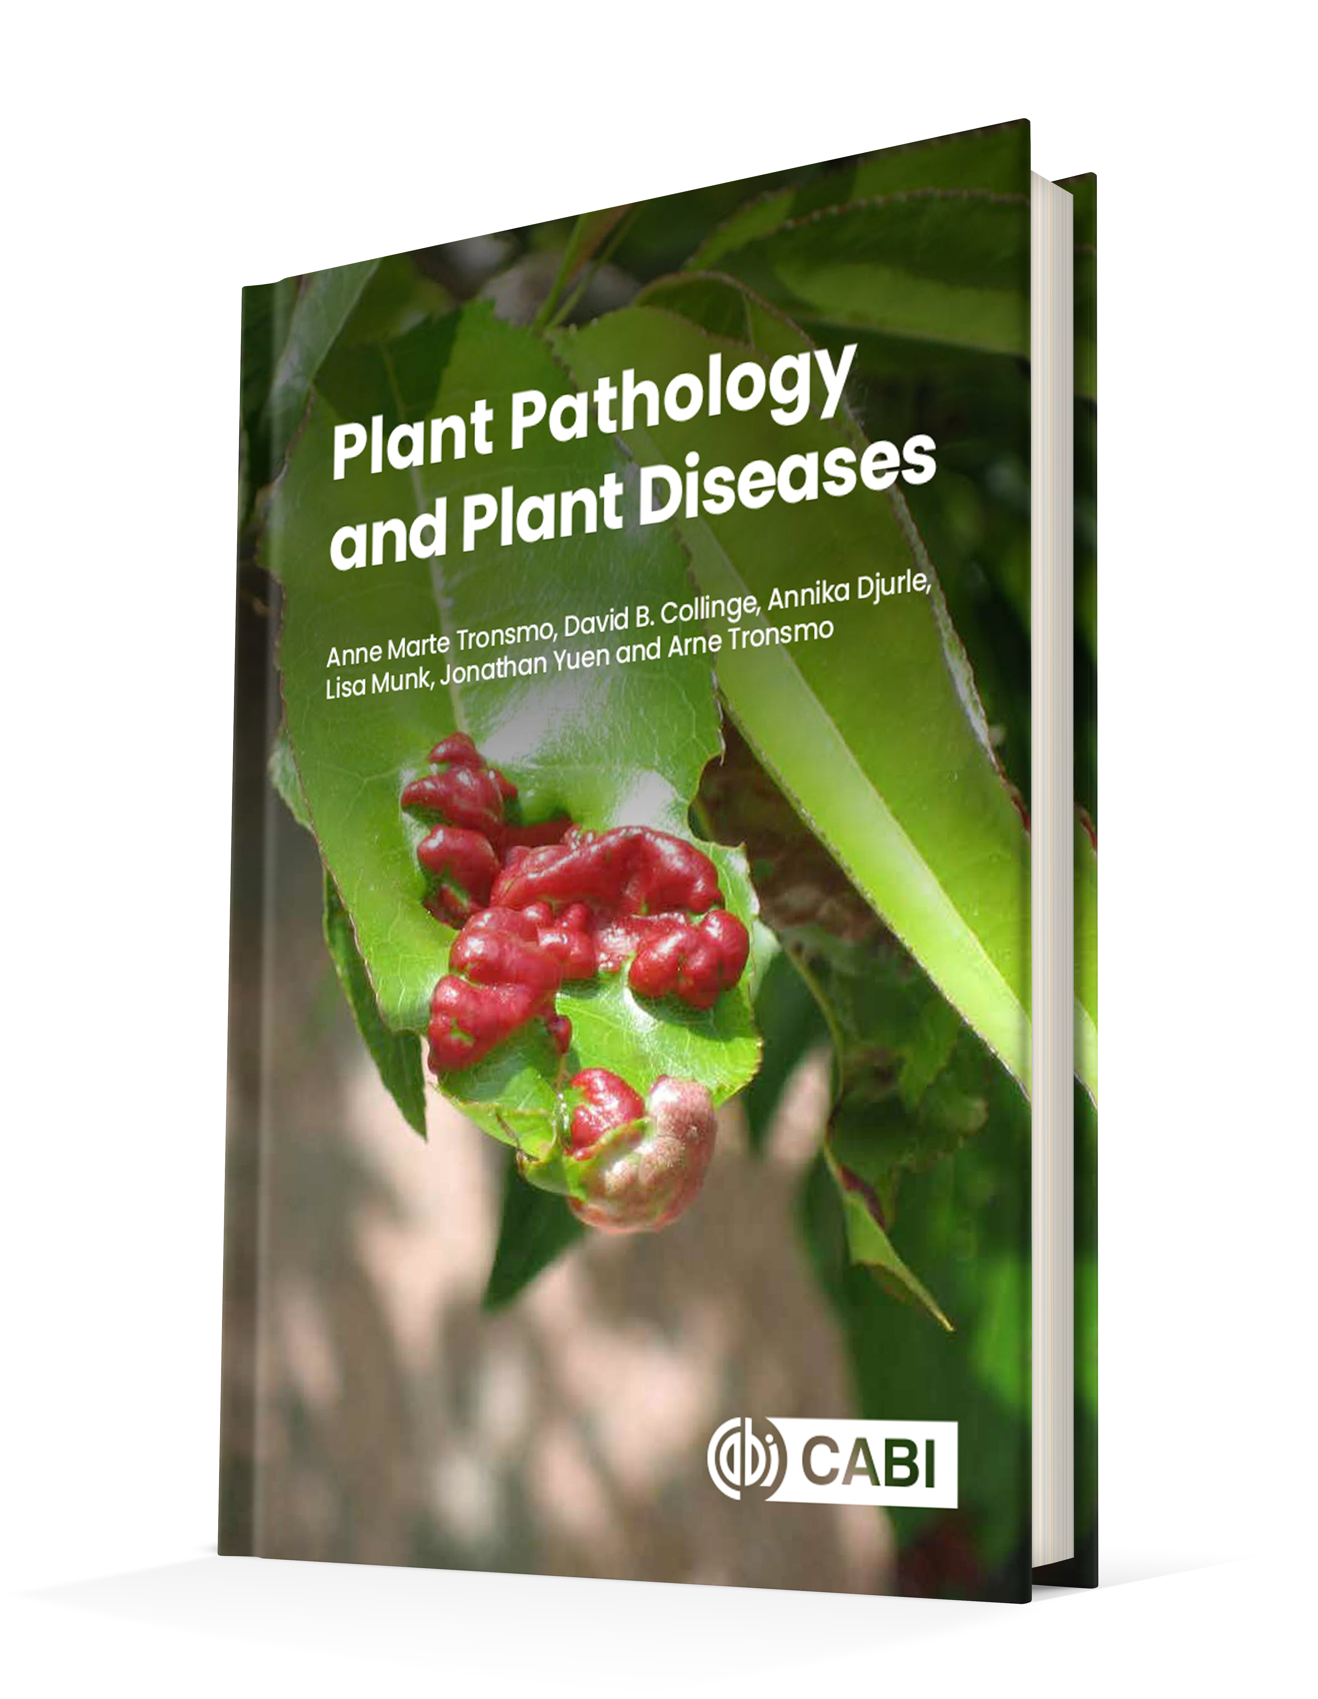
Plant Pathology and Plant Diseases
© Anne Marte Tronsmo, David B. Collinge, Annika Djurle, Lisa Munk, Jonathan Yuen and Arne Tronsmo 2020

Slide 2
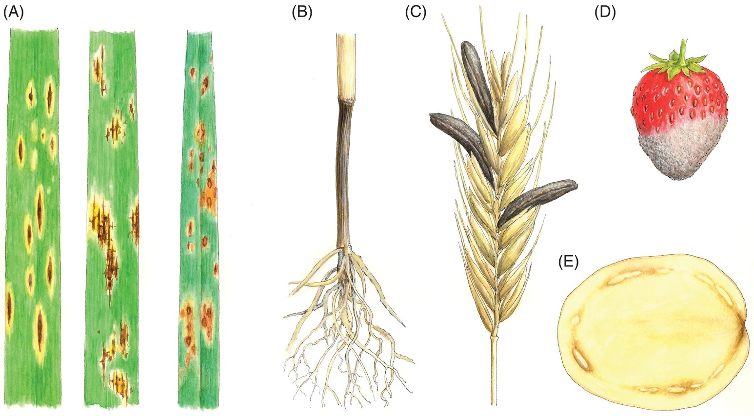
Fig. 1.1 Examples of symptoms of diseases and signs of plant pathogens.
(A) Various leaf spots on cereals. (B) Fusarium foot rot in wheat. (C) Sclerotia of ergot in rye (Secale cereale). (D) Grey mould in strawberry (E) Necrotic tissue and bacterial slime due to ring rot in potato tuber. (© NIBIO.) H. Karlsen
Plant Pathology and Plant Diseases © Anne Marte Tronsmo, David B. Collinge, Annika Djurle, Lisa Munk, Jonathan Yuen and Arne Tronsmo 2020

Slide 3
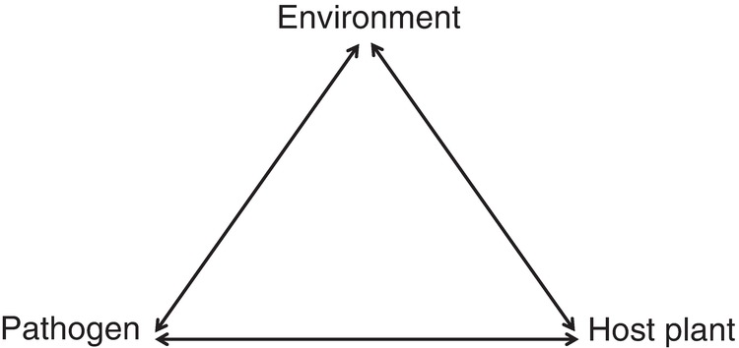
Fig. 1.2 The disease triangle
© A. Djurle.
Plant Pathology and Plant Diseases © Anne Marte Tronsmo, David B. Collinge, Annika Djurle, Lisa Munk, Jonathan Yuen and Arne Tronsmo 2020

Slide 4
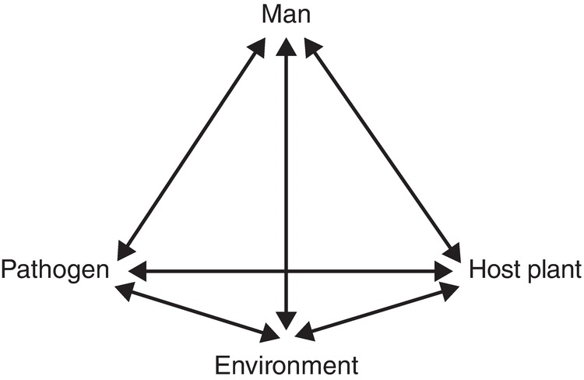
Fig. 1.3 The disease tetrahedron
© A. Djurle.
Plant Pathology and Plant Diseases © Anne Marte Tronsmo, David B. Collinge, Annika Djurle, Lisa Munk, Jonathan Yuen and Arne Tronsmo 2020

