Slide 1
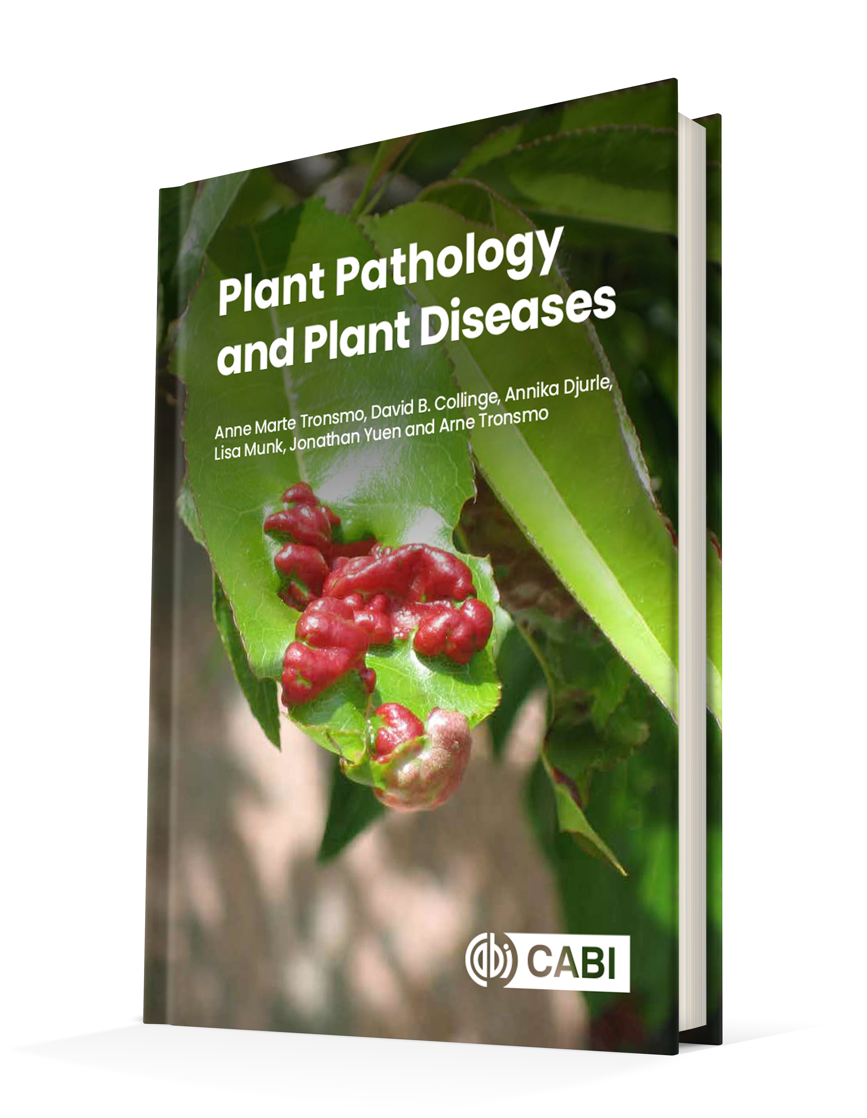
Plant Pathology and Plant Diseases
© Anne Marte Tronsmo, David B. Collinge, Annika Djurle, Lisa Munk, Jonathan Yuen and Arne Tronsmo 2020

Slide 2
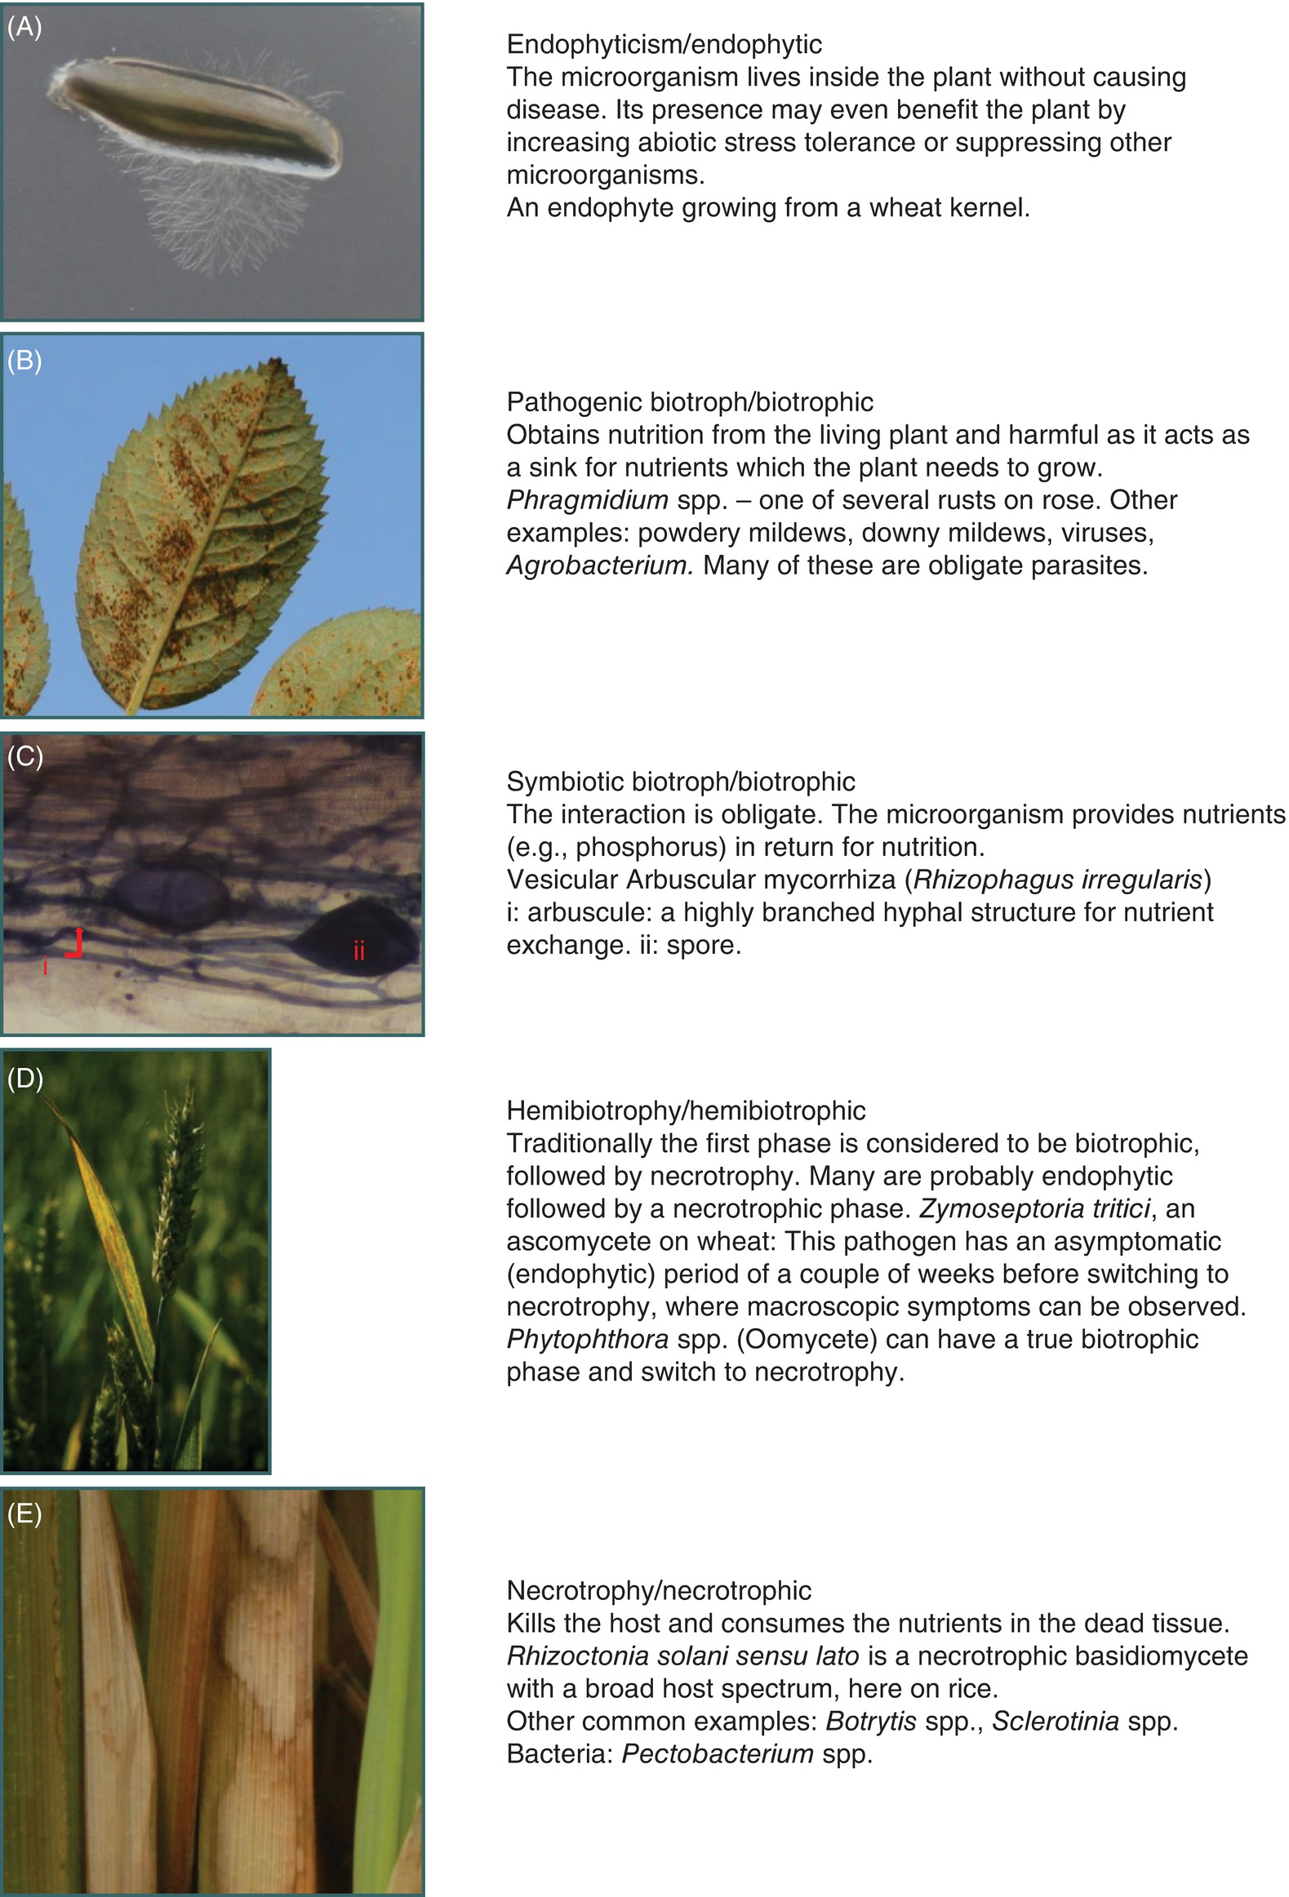
Fig. 3.1 A-E
Examples of lifestyles exhibited by fungi associated with plants: (A) Endophytic; (B) Pathogenic biotrophic; (C) Symbiotic biotroph; (D) Hemiobiotropic; (E) Necrotrophic. (A,B,D,E © D.B.Collinge C: © Eva Lucic.)
Plant Pathology and Plant Diseases
© Anne Marte Tronsmo, David B. Collinge, Annika Djurle, Lisa Munk, Jonathan Yuen and Arne Tronsmo 2020

Slide 3
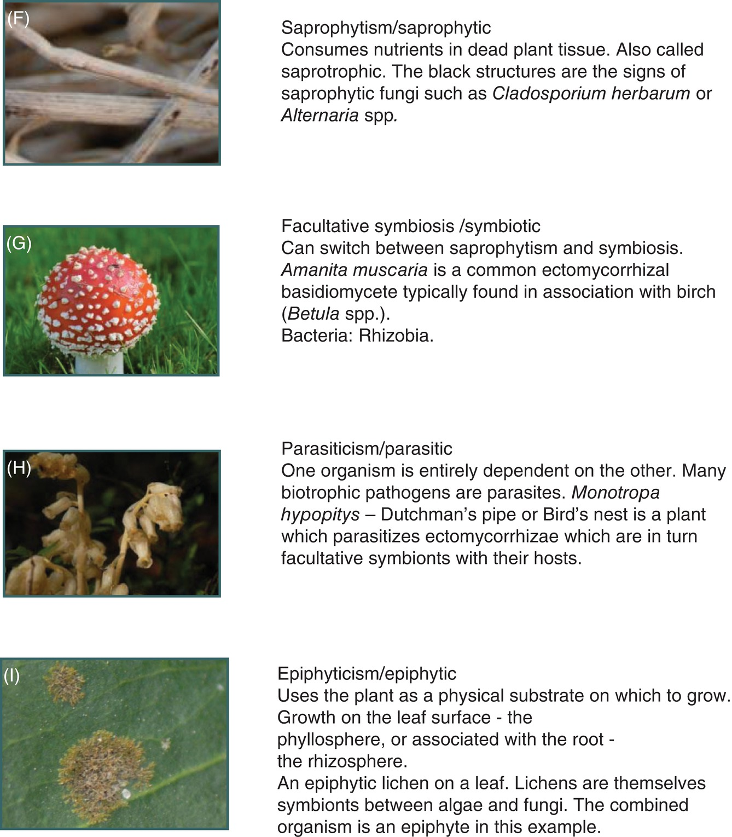
Fig. 3.1 F – I
Examples of lifestyles exhibited by fungi associated with plants: F) Saprophytic; (G) Facultative symbiosis; (H) Parasitic; (I) Epiphytic. (© D.B.Collinge.)
Plant Pathology and Plant Diseases
© Anne Marte Tronsmo, David B. Collinge, Annika Djurle, Lisa Munk, Jonathan Yuen and Arne Tronsmo 2020

Slide 4
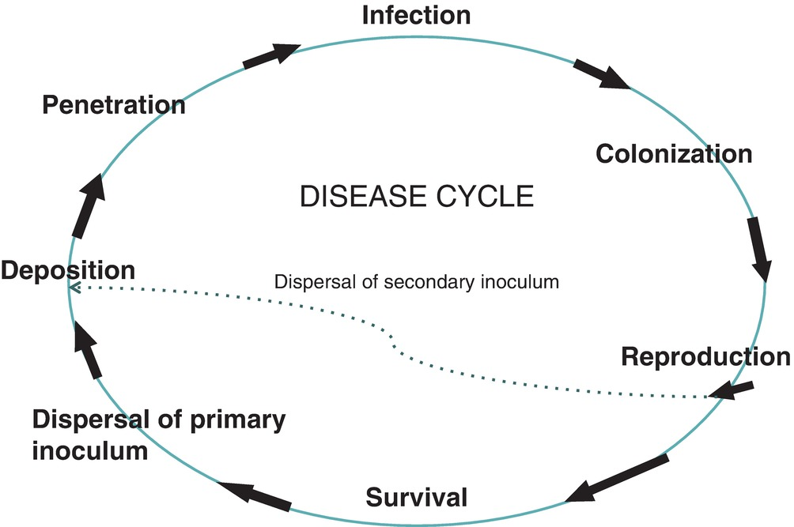
Fig. 3.2 Schematic illustration of a generalized disease cycle. (©A.M. Tronsmo.)
Plant Pathology and Plant Diseases
© Anne Marte Tronsmo, David B. Collinge, Annika Djurle, Lisa Munk, Jonathan Yuen and Arne Tronsmo 2020

Slide 5
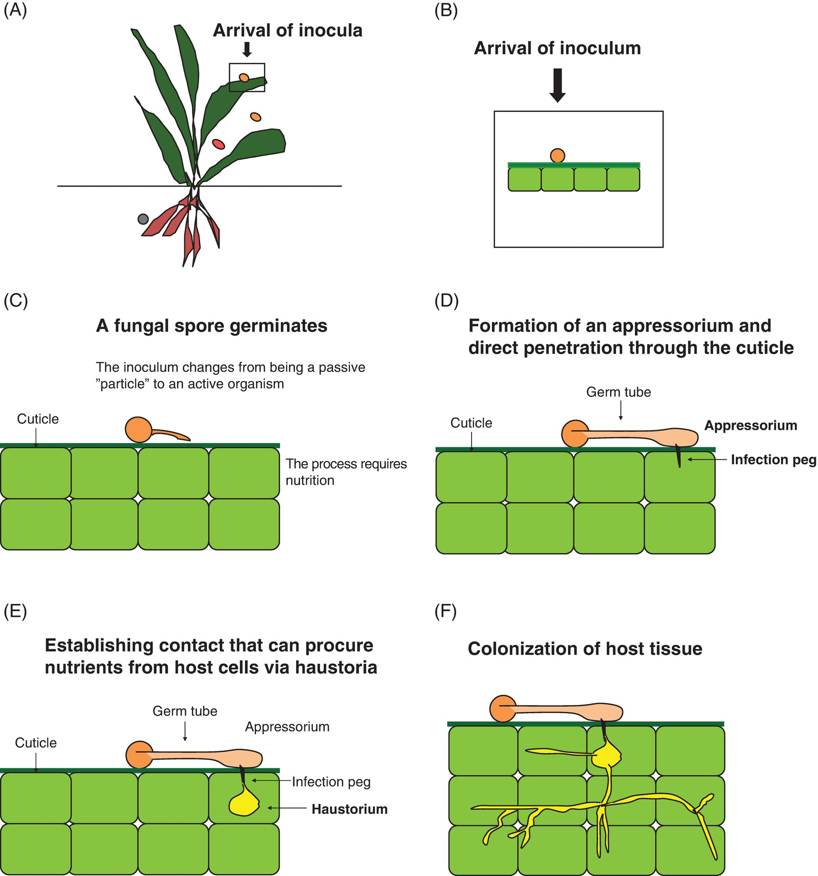
Fig. 3.3 Stages in a disease cycle. A and B: Arrival of inoculum; C: Germinating spore; D: Formation of appresorium, infection peg (a specialized hypha) and cuticle penetration; E: The pathogen procure nutrients from the host via a haustorium (feeding hypha); F: Colonization of the host tissue. (© A.M. Tronsmo.)
Plant Pathology and Plant Diseases
© Anne Marte Tronsmo, David B. Collinge, Annika Djurle, Lisa Munk, Jonathan Yuen and Arne Tronsmo 2020

Slide 6
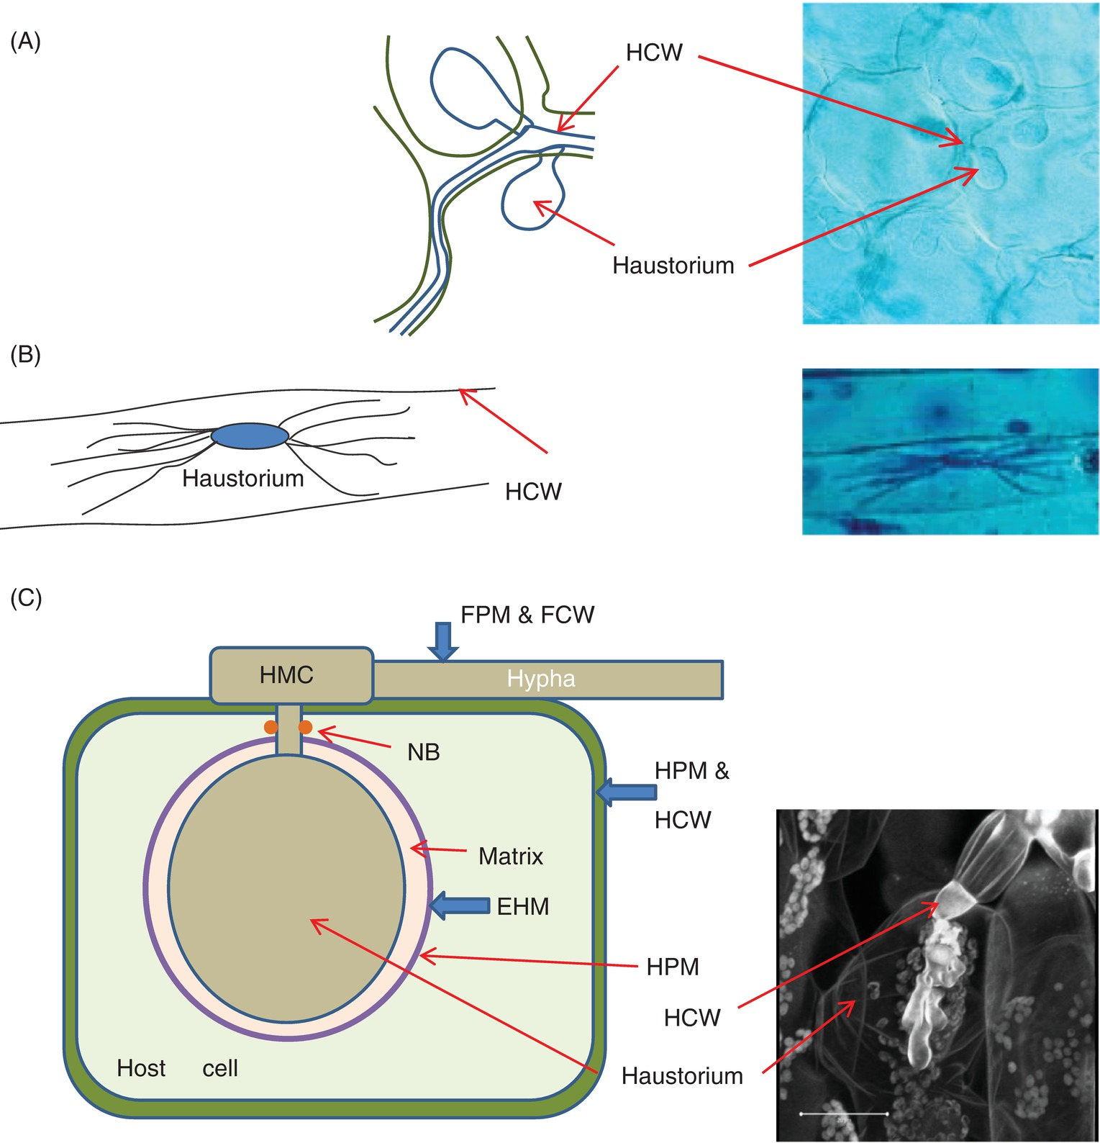
Fig. 3.4
Illustrations of haustoria from fungal and oomycete pathogens. (A) Hyaloperonospora parasitica causing downy mildew in broccoli; (B) Blumeria graminis causing powdery mildew in a barley epidermal cell; (C) Hemileia vastatrix causing coffee rust and Puccinia striiformis causing yellow rust on wheat. (A: © B. Dahl Jensen, B: © Y. Wei & C: C. K. Sørensen; Drawings © D.B.Collinge.)
Plant Pathology and Plant Diseases
© Anne Marte Tronsmo, David B. Collinge, Annika Djurle, Lisa Munk, Jonathan Yuen and Arne Tronsmo 2020

Slide 7
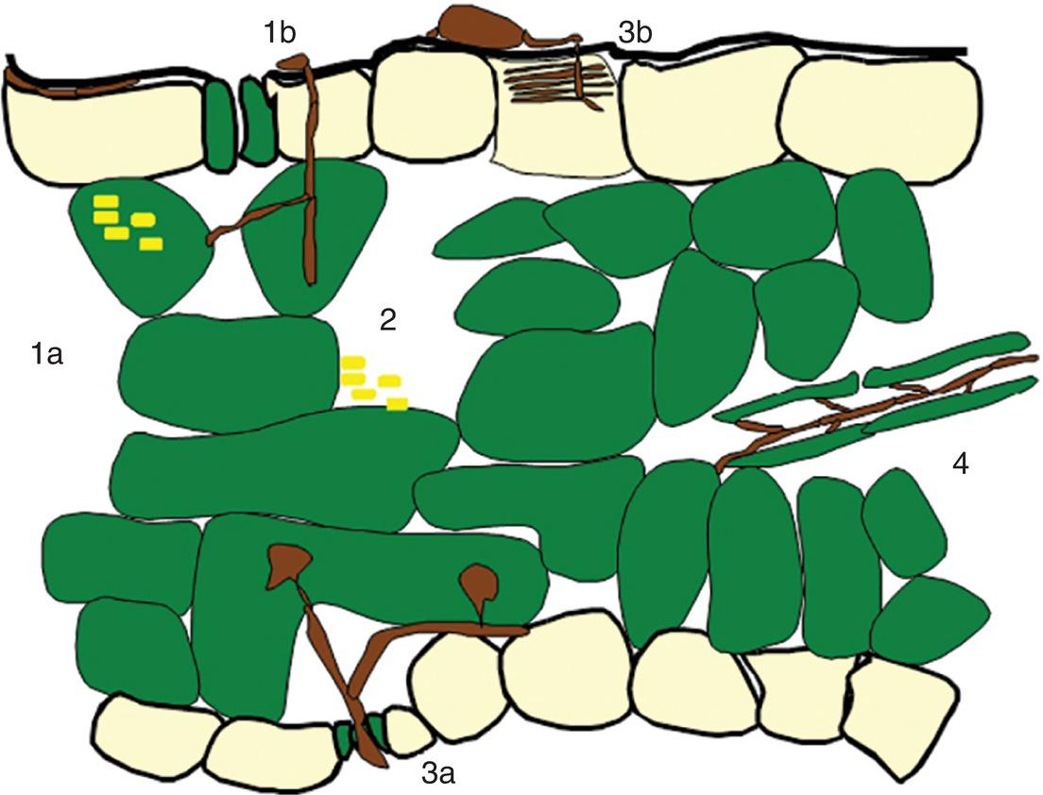
Fig. 3.5 Choice of niche. (1a) Intracellular (e.g. virus). (1b) Invasively – direct penetration; (2) Intercellular (e.g. bacteria); (3) Intercellular with haustoria entry via stoma (3a, e.g. rust) or essentially epiphytic with haustoria (3b, e.g. powdery mildew); (4) Vascular (e.g. vascular wilt bacteria and fungi, phytoplasma). (© D.B. Collinge.)
Plant Pathology and Plant Diseases
© Anne Marte Tronsmo, David B. Collinge, Annika Djurle, Lisa Munk, Jonathan Yuen and Arne Tronsmo 2020

Slide 8
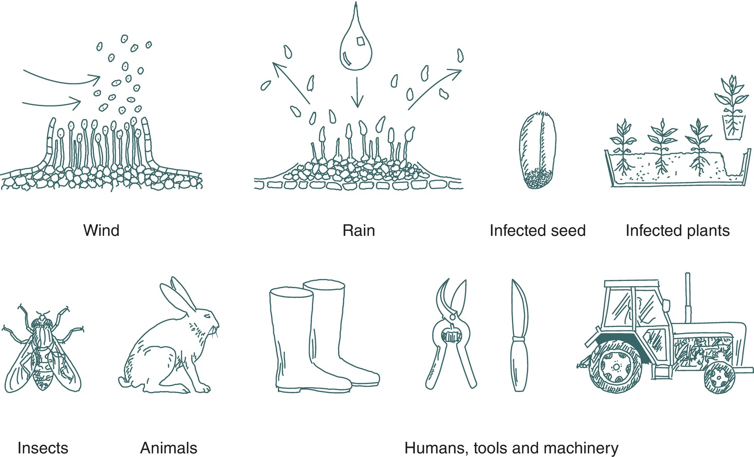
Fig. 3.6 Dispersal of plant pathogens. Drawing H. Karlsen
(© NIBIO.)
Plant Pathology and Plant Diseases
© Anne Marte Tronsmo, David B. Collinge, Annika Djurle, Lisa Munk, Jonathan Yuen and Arne Tronsmo 2020

Slide 9
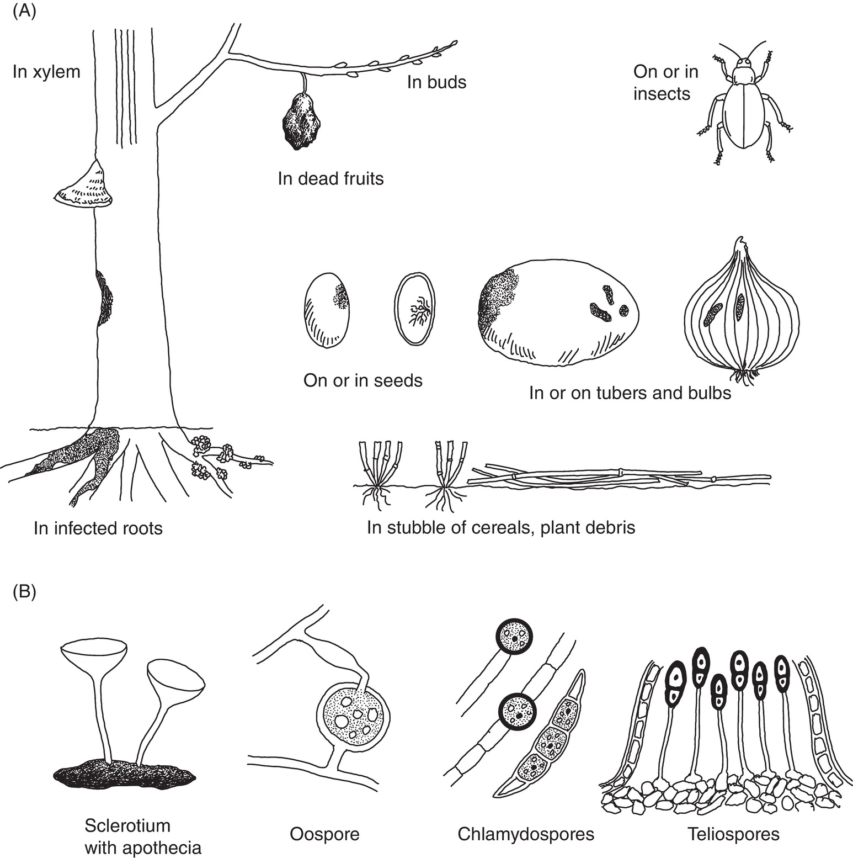
Fig. 3.7
A Some means of survival of plant pathogens. (© NIBIO.)
B Structures for survival of fungi and oomcetes. (Drawing H. Karlsen © NIBIO.)
Plant Pathology and Plant Diseases
© Anne Marte Tronsmo, David B. Collinge, Annika Djurle, Lisa Munk, Jonathan Yuen and Arne Tronsmo 2020

Slide 10
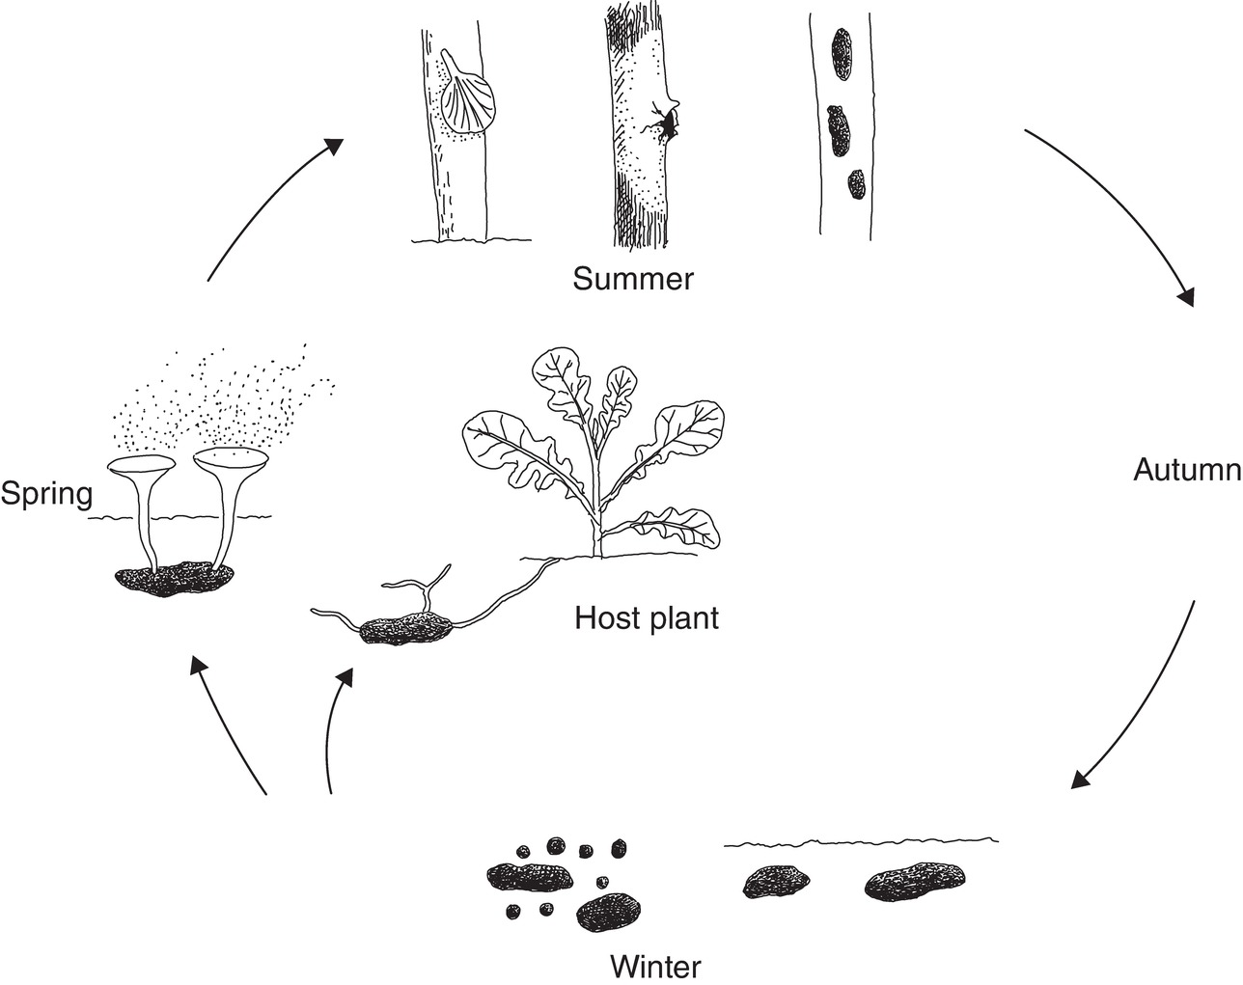
Fig. 3.8 Example of a disease cycle for a monocyclic pathogen, Sclerotinia sclerotiorum. (Drawing H. Karlsen, © NIBIO.)
Plant Pathology and Plant Diseases
© Anne Marte Tronsmo, David B. Collinge, Annika Djurle, Lisa Munk, Jonathan Yuen and Arne Tronsmo 2020

