Slide 1
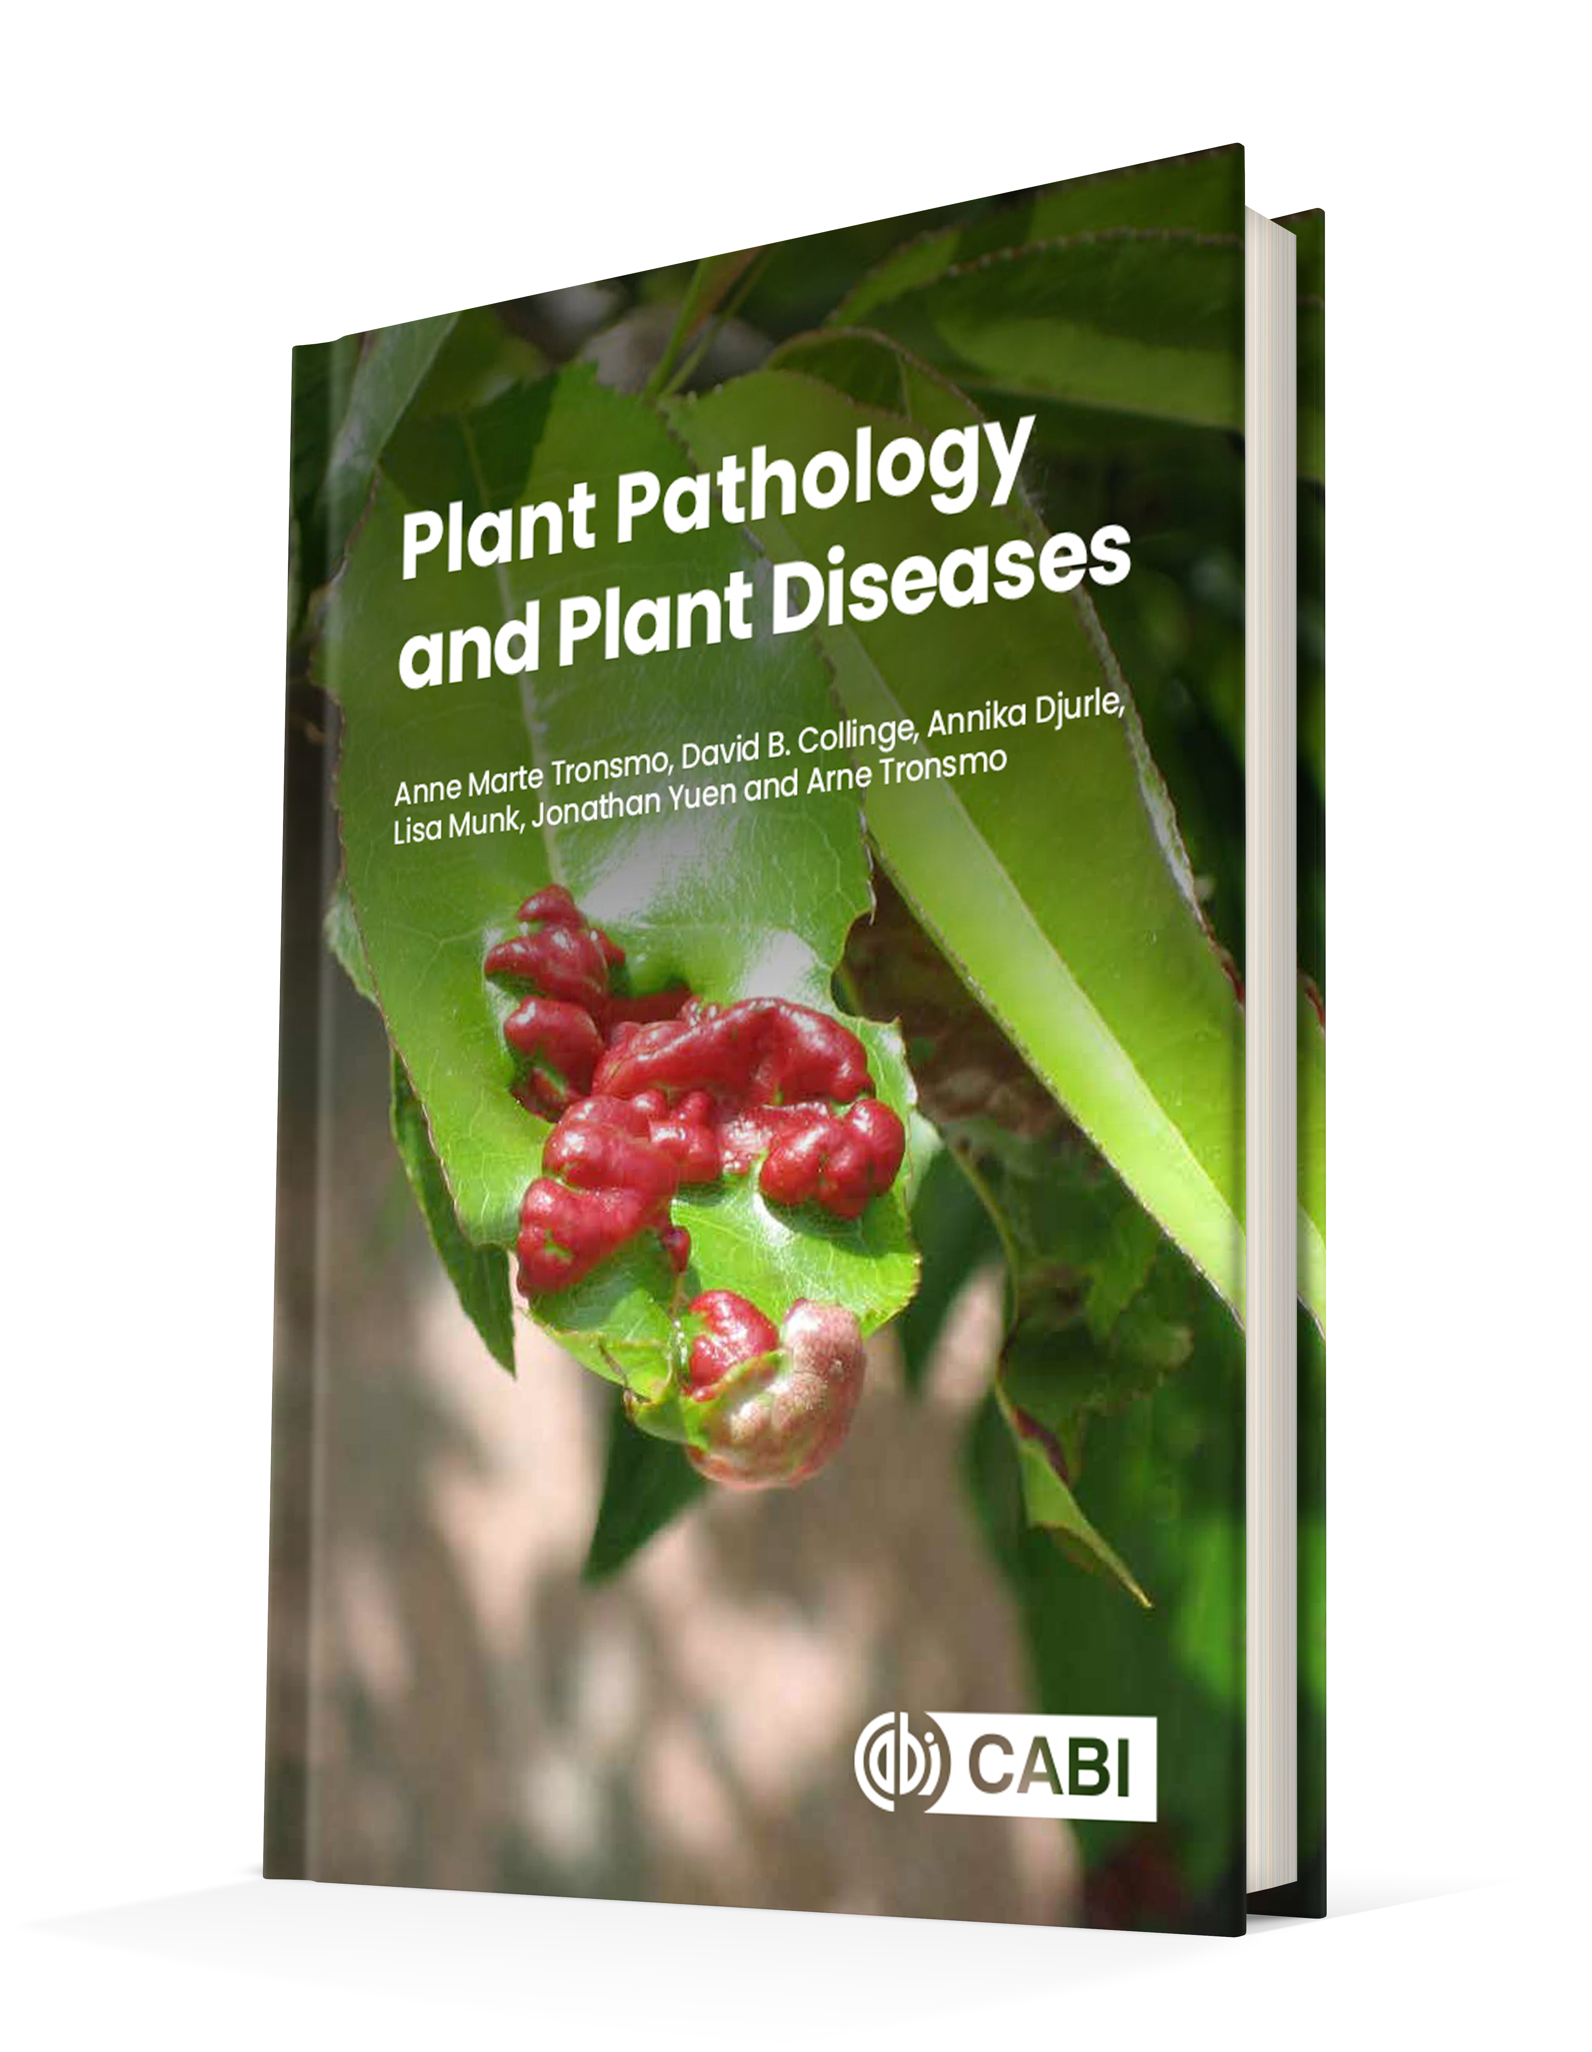
Plant Pathology and Plant Diseases
© Anne Marte Tronsmo, David B. Collinge, Annika Djurle, Lisa Munk, Jonathan Yuen and Arne Tronsmo 2020

Slide 2
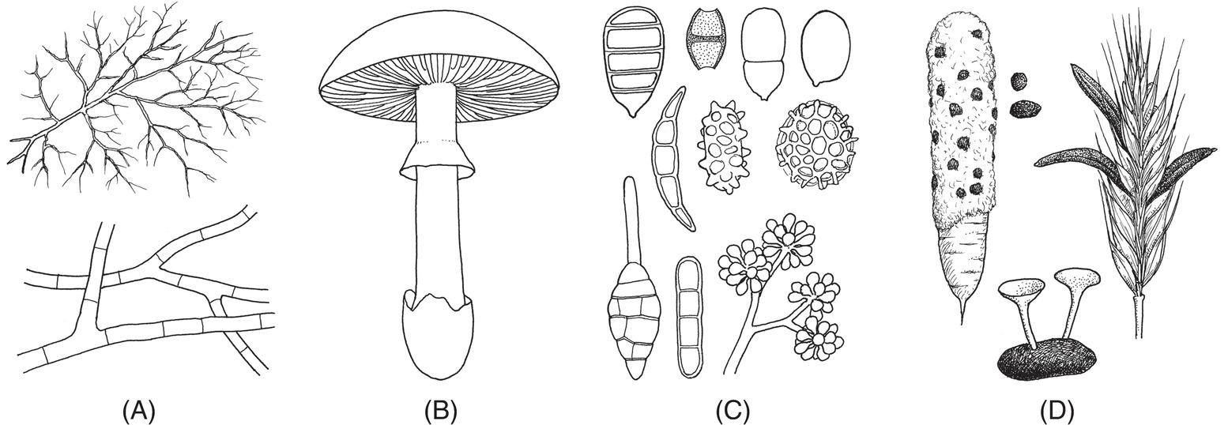
Fig. 4.1
Characteristic fungal structures. (A) Mycelium of hyphae with transverse walls. (B) Toadstool. (C) Different types of spores. (D) Sclerotia embedded in mycelium on carrot; a sclerotium germinating with two apothecia; and ergot ‘grains’ (sclerotia) among the seed in a grain head. (© H. Karlsen.)
Plant Pathology and Plant Diseases
© Anne Marte Tronsmo, David B. Collinge, Annika Djurle, Lisa Munk, Jonathan Yuen and Arne Tronsmo 2020

Slide 3
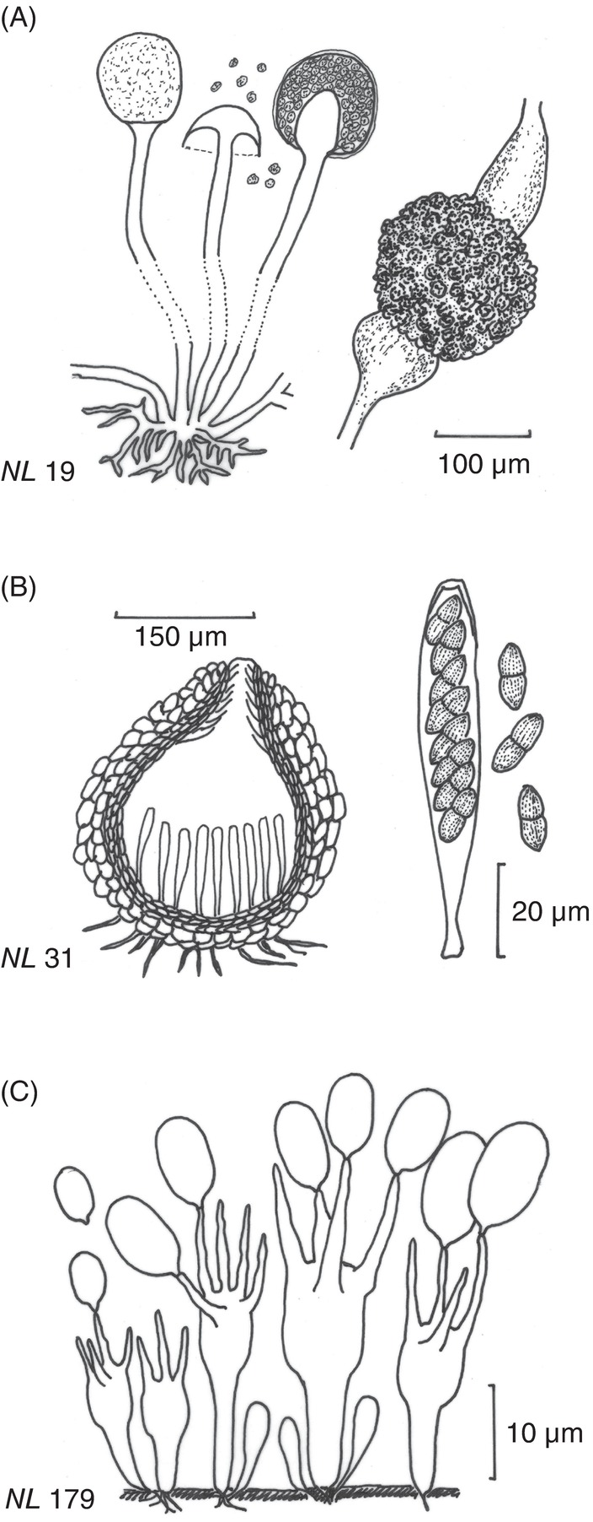
Fig. 4.2
Sexual structures and spores in different phyla of fungi. (A) Zygospore. (B) Fruiting body and asci with ascospores. (C) Basidiospores on basidium. (N. Leroul, courtesy of J. Hockenhull et al.)
Plant Pathology and Plant Diseases
© Anne Marte Tronsmo, David B. Collinge, Annika Djurle, Lisa Munk, Jonathan Yuen and Arne Tronsmo 2020

Slide 4
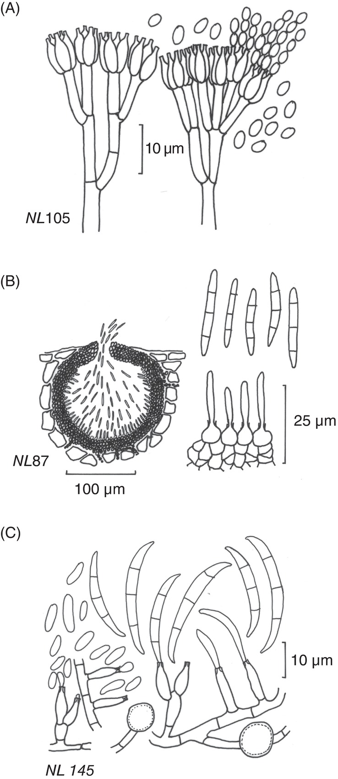
Fig. 4.3
Common types of asexual spores in fungi. (A) Conidia and conidiophores of Penicillium spp. (B) Conidia formed in asexual fruiting body (pycnidium) (C) Chlamydospores (N. Leroul, courtesy of J. Hockenhull et al.)
Plant Pathology and Plant Diseases
© Anne Marte Tronsmo, David B. Collinge, Annika Djurle, Lisa Munk, Jonathan Yuen and Arne Tronsmo 2020

Slide 5
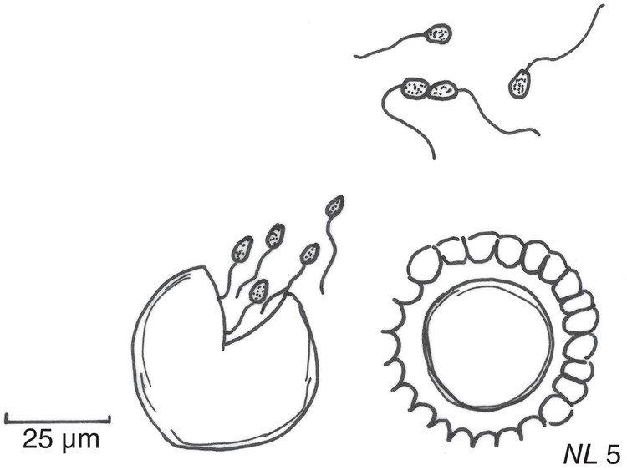
Fig. 4.4 Synchytrium endobioticum structures. Haploid zoospores emerging from a resting spore, fusion of two zoospores and a prosorus. (N. Leroul, courtesy of J. Hockenhull et al.)
Plant Pathology and Plant Diseases
© Anne Marte Tronsmo, David B. Collinge, Annika Djurle, Lisa Munk, Jonathan Yuen and Arne Tronsmo 2020

Slide 6
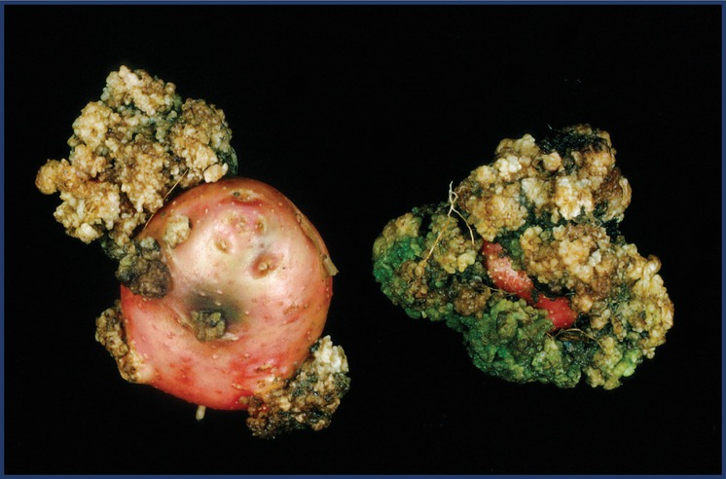
Fig. 4.5
A potato with potato wart (Synchytrium endobioticum). (L.R. Hansen © NIBIO.)
Plant Pathology and Plant Diseases
© Anne Marte Tronsmo, David B. Collinge, Annika Djurle, Lisa Munk, Jonathan Yuen and Arne Tronsmo 2020

Slide 7
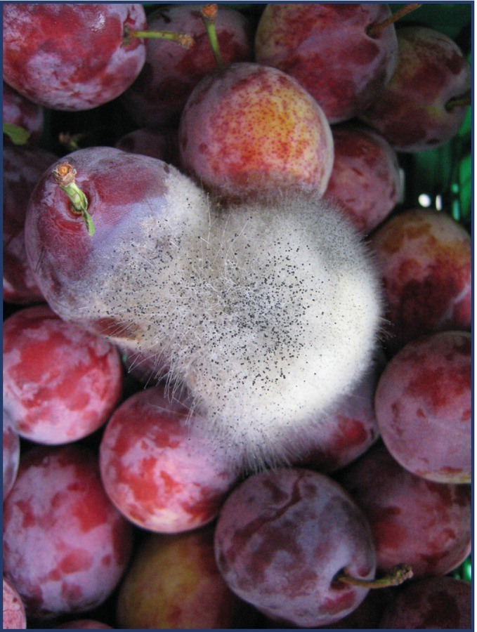
Fig. 4.6 Mucor spp. on a plum. (J Bøvre © NIBIO.)
Plant Pathology and Plant Diseases
© Anne Marte Tronsmo, David B. Collinge, Annika Djurle, Lisa Munk, Jonathan Yuen and Arne Tronsmo 2020

Slide 8
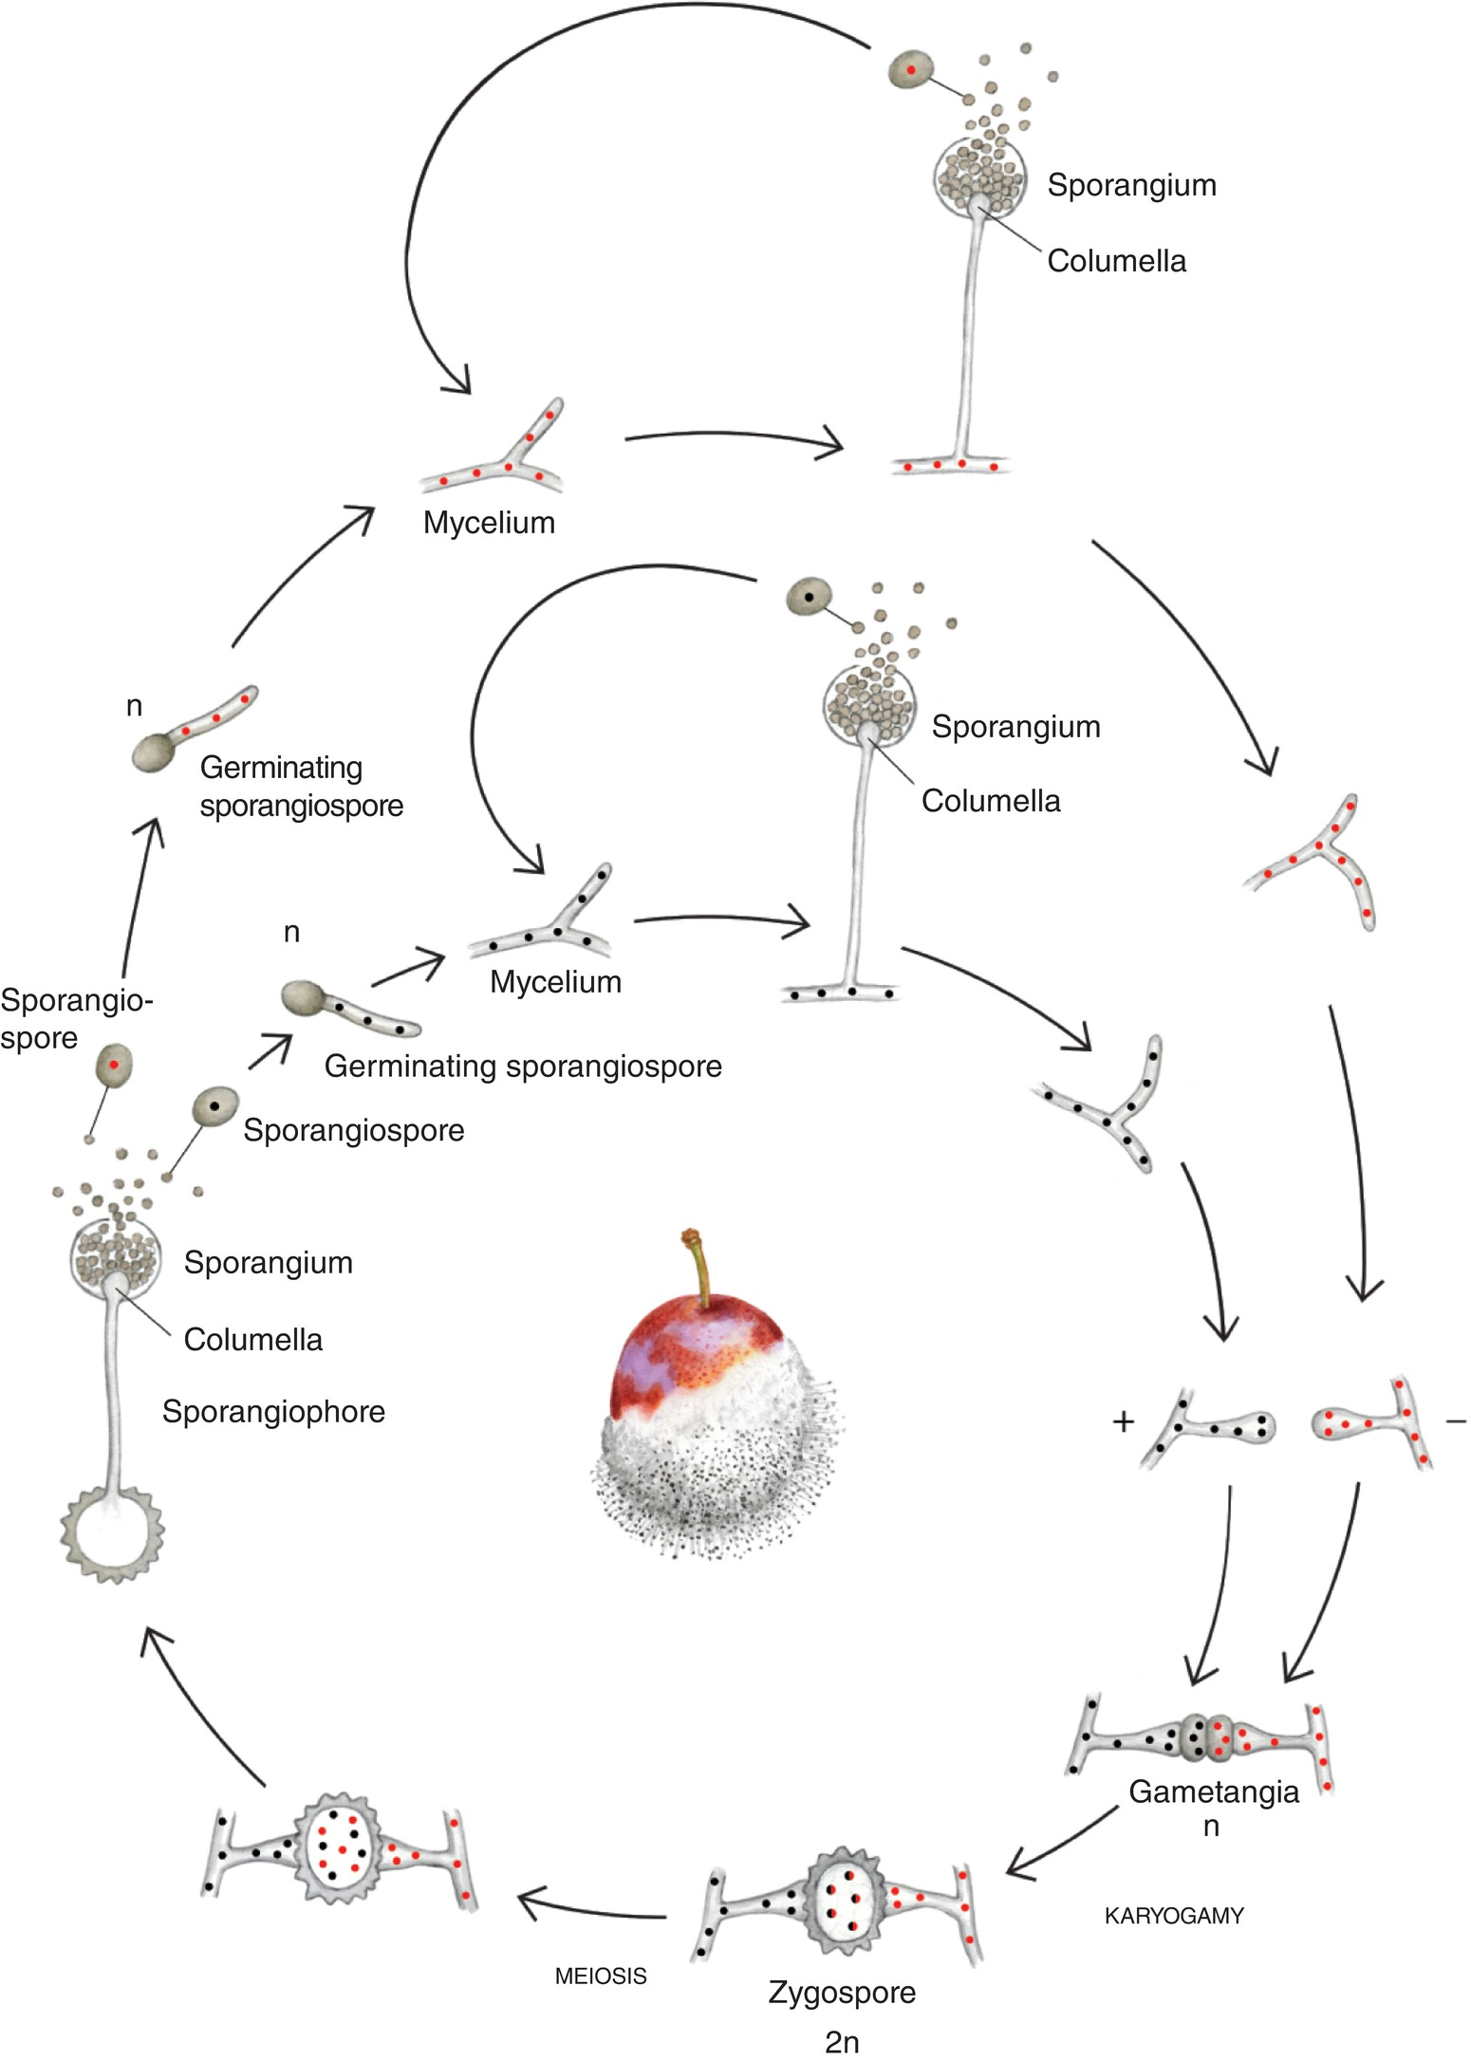
Fig. 4.7
Life cycle of Zygomycota (Mucor spp.): sexual and asexual stages. (© H. Karlsen.)
Plant Pathology and Plant Diseases
© Anne Marte Tronsmo, David B. Collinge, Annika Djurle, Lisa Munk, Jonathan Yuen and Arne Tronsmo 2020

Slide 9
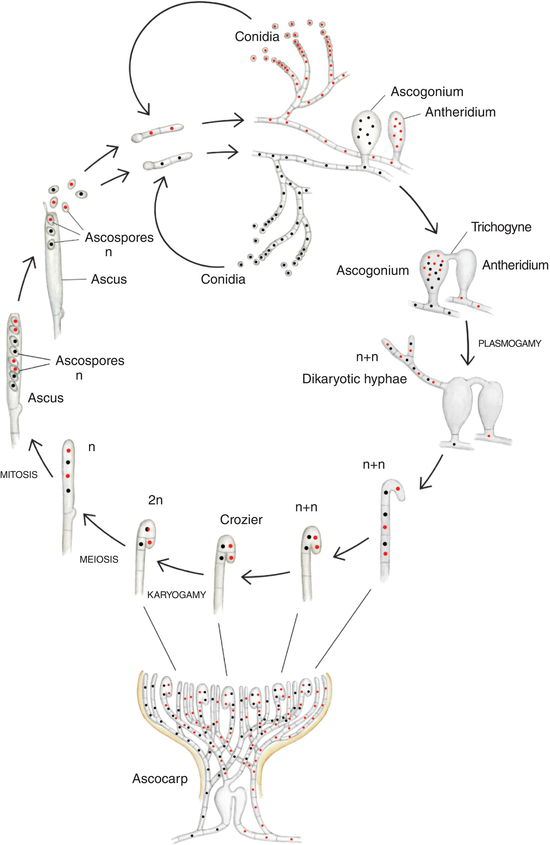
Fig. 4.8 Life cycle of an ascomycete, sexual and asexual stages. (© H. Karlsen.)
Plant Pathology and Plant Diseases
© Anne Marte Tronsmo, David B. Collinge, Annika Djurle, Lisa Munk, Jonathan Yuen and Arne Tronsmo 2020

Slide 10
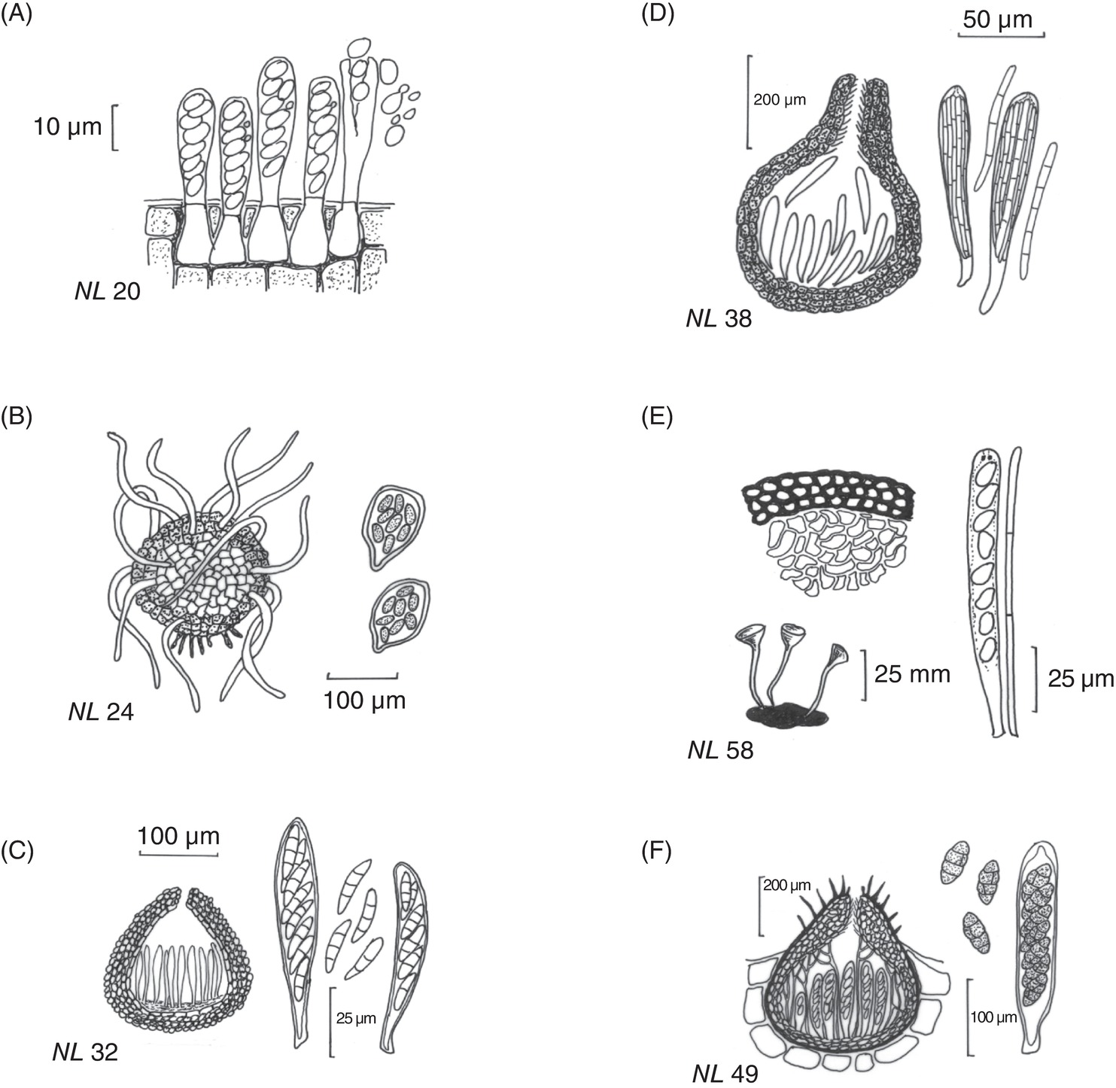
Fig. 4.9 Different types of sexual fruiting bodies, ascocarps, and asci in Ascomycota. (A) No ascocarp (naked asci): (B) Chasmothecium. (C) Perithecium: (D) Perithecium: (E) Apothecia on a sclerotium: the figure also shows a cross-section of a sclerotium. (F) Pseudothecium (ascostroma): (N. Leroul, courtesy of J. Hockenhull et al.)
Plant Pathology and Plant Diseases
© Anne Marte Tronsmo, David B. Collinge, Annika Djurle, Lisa Munk, Jonathan Yuen and Arne Tronsmo 2020

Slide 11
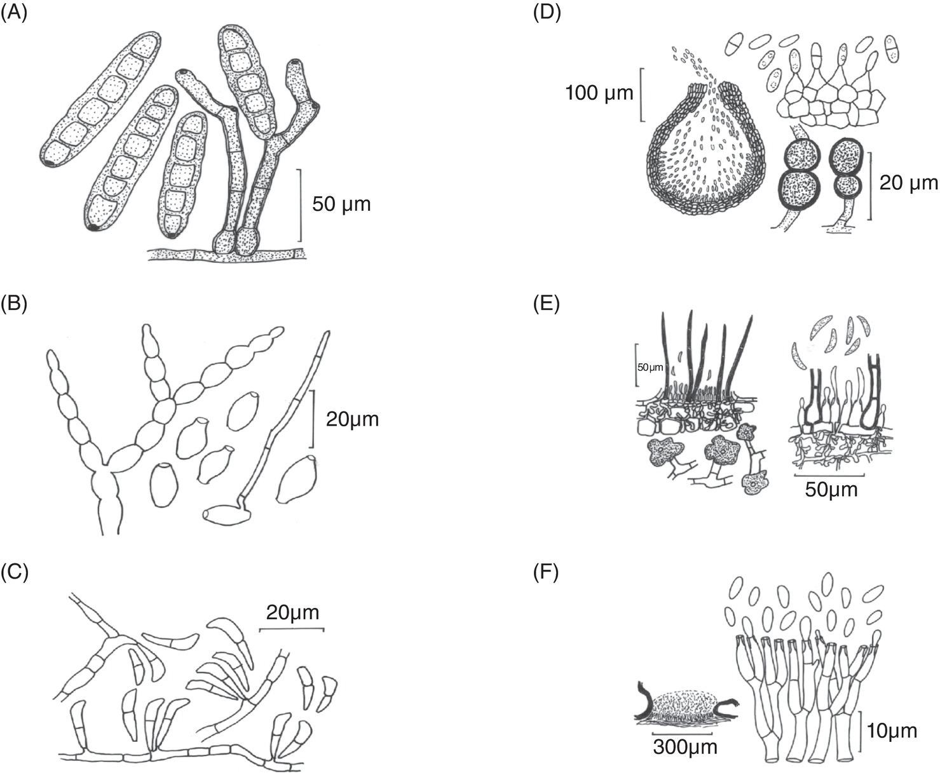
Fig. 4.10 Asexual propagation structures in Ascomycota. (A) Conidia of Pyrenophora teres. (B) Conidia of Monilinia fructigena. (C) Conidia of Rhynchosporium graminicola. (D) Pycnidium with conidia and chlamydospores of Didymella pinodella. (E) Acervulus of Colletotrichum spp. (F) Sporodochium of Nectria. (N. Leroul, courtesy of J. Hockenhull et al.)
Plant Pathology and Plant Diseases
© Anne Marte Tronsmo, David B. Collinge, Annika Djurle, Lisa Munk, Jonathan Yuen and Arne Tronsmo 2020

Slide 12
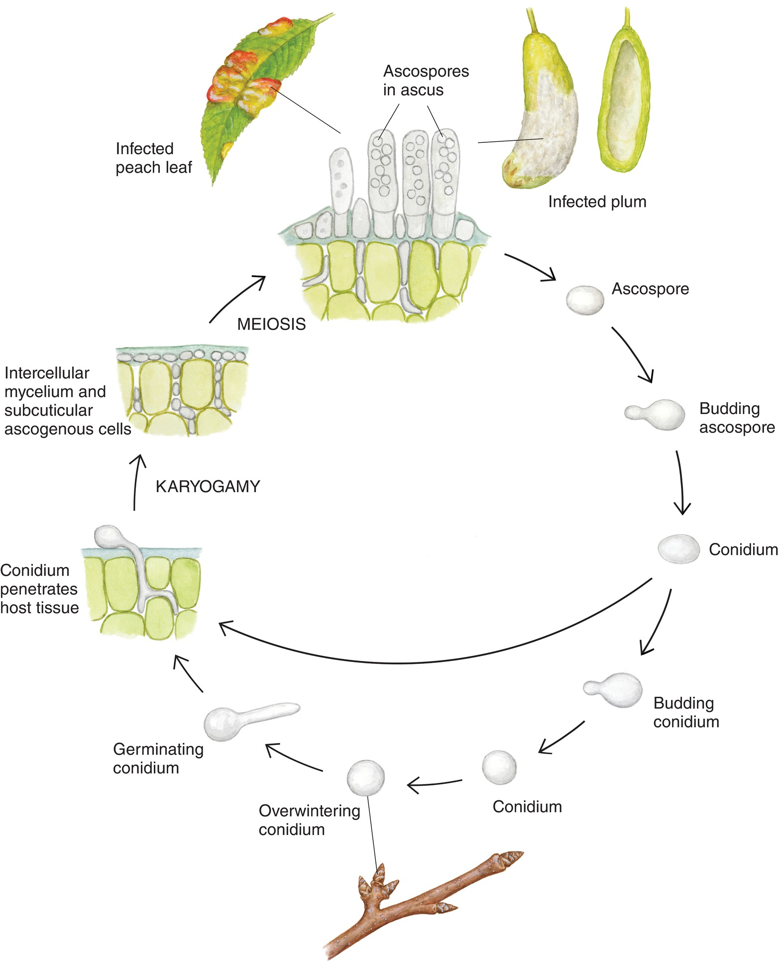
Fig. 4.11 Disease cycle of Taphrina spp. on peach and plum. (© H. Karlsen.)
Plant Pathology and Plant Diseases
© Anne Marte Tronsmo, David B. Collinge, Annika Djurle, Lisa Munk, Jonathan Yuen and Arne Tronsmo 2020

Slide 13
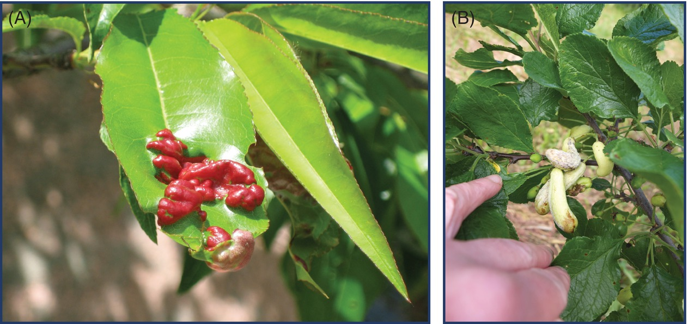
Fig. 4.12 (A) Peach leaf curl caused by Taphrina deformans. (B) Plum pocket caused by T. pruni. (A: © L. Munk; B: J. Bøvre © NIBIO.)
Plant Pathology and Plant Diseases
© Anne Marte Tronsmo, David B. Collinge, Annika Djurle, Lisa Munk, Jonathan Yuen and Arne Tronsmo 2020

Slide 14
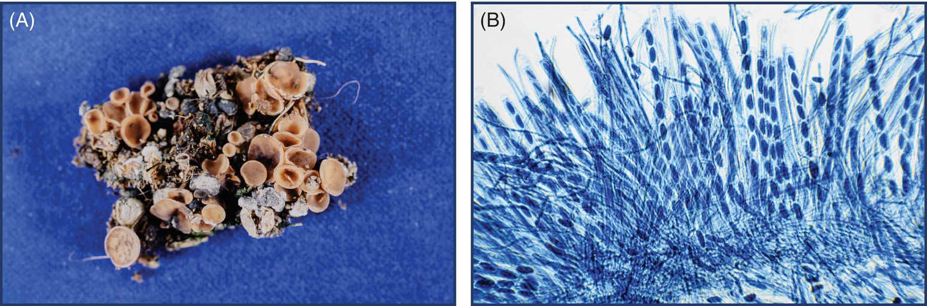
Fig. 4.13 (A) Apothecia of Sclerotinia borealis germinated from sclerotia. (B) Asci with ascospores and paraphyses. (© A.M. Tronsmo.)
Plant Pathology and Plant Diseases
© Anne Marte Tronsmo, David B. Collinge, Annika Djurle, Lisa Munk, Jonathan Yuen and Arne Tronsmo 2020

Slide 15
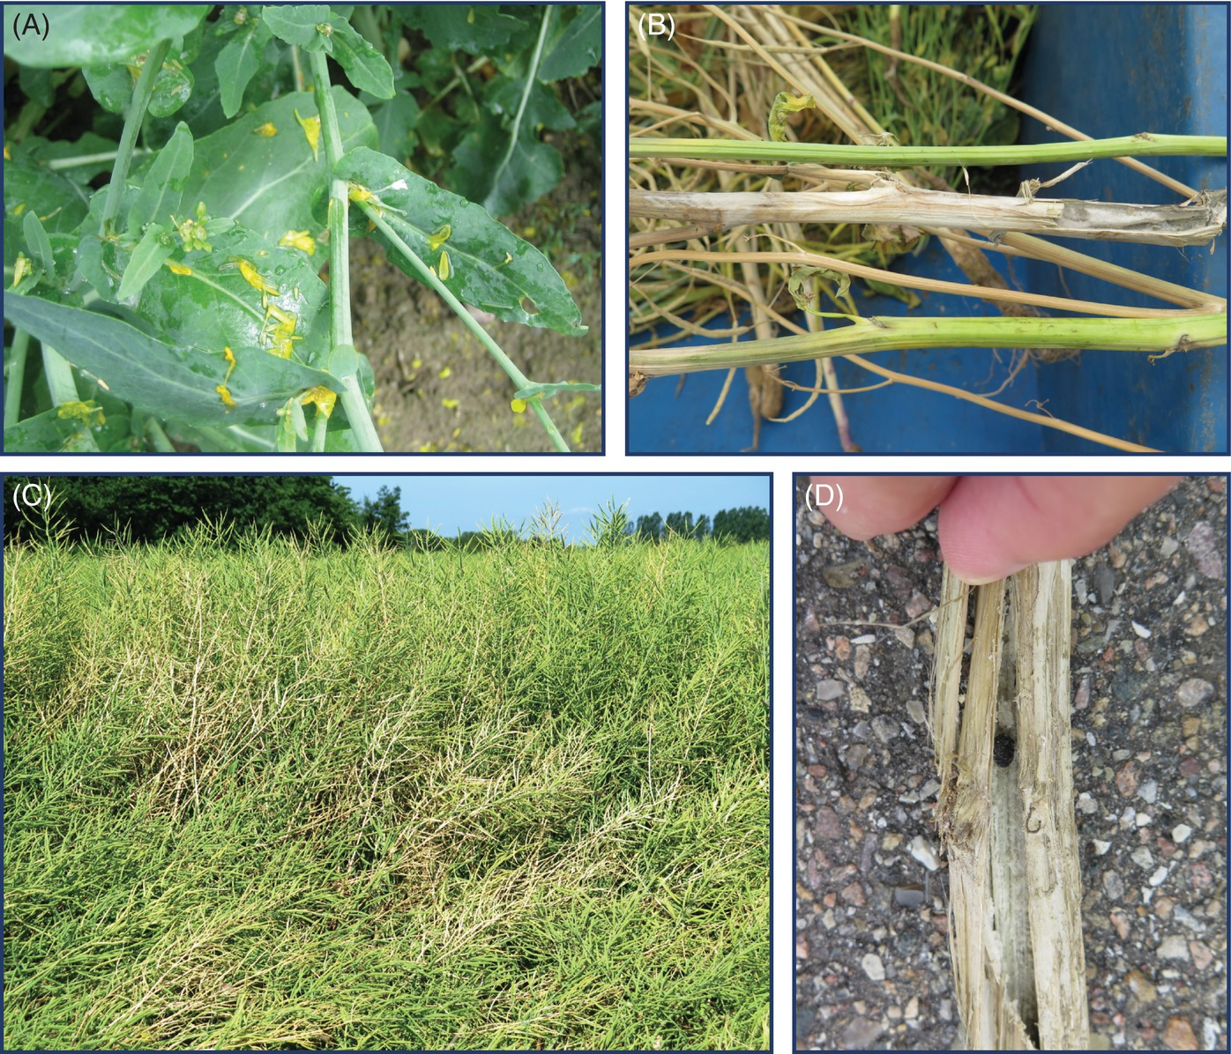
Fig. 4.14 Different stages of sclerotinia stem rot, caused by Sclerotinia sclerotiorum, in oilseed rape. (A) Petals falling on leaves. (B) Greyish lesion around the infection point. (C) Diseased plants between healthy plants. (D) A sclerotium inside a stem. (© L. Munk.)
Plant Pathology and Plant Diseases
© Anne Marte Tronsmo, David B. Collinge, Annika Djurle, Lisa Munk, Jonathan Yuen and Arne Tronsmo 2020

Slide 16
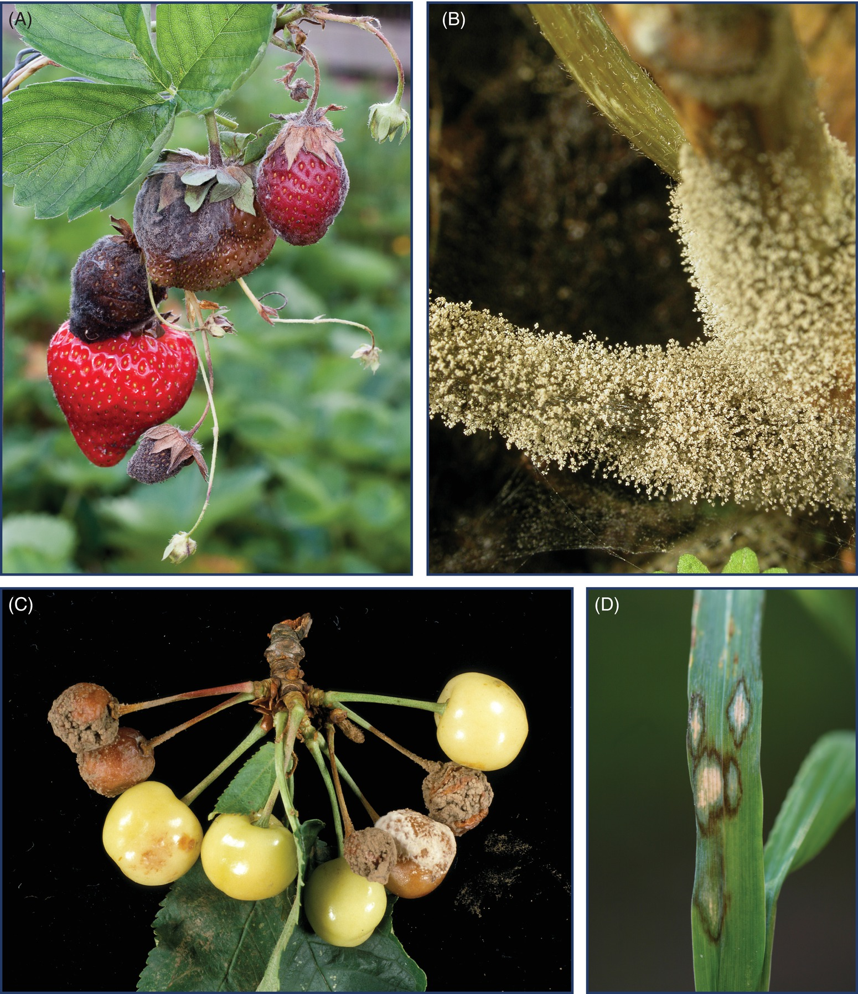
Fig. 4.15 (A) Botrytis cinerea sporulating (conidia) on strawberry. (B) Stem of Poinsettia with ‘fur’ of conidia. (© NIBIO.)
(C) Cherries (Prunus cerasus) with Monilinia laxa infection. (D) Leaf
blotch caused by Rhynchosporium graminicola on barley
(A, B, C: E. Fløistad © NIBIO; D: courtesy of P. Waern, Swedish Board of Agriculture.)
Plant Pathology and Plant Diseases
© Anne Marte Tronsmo, David B. Collinge, Annika Djurle, Lisa Munk, Jonathan Yuen and Arne Tronsmo 2020

Slide 17
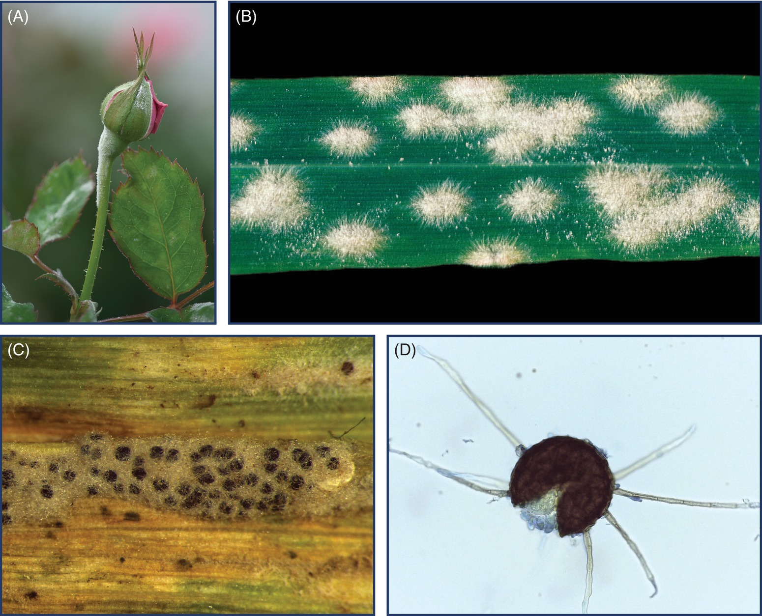
Fig. 4.16 Powdery mildew. (A) The conidial stage of Podosphaera pannosa on rose bud. (B) The conidial stage of Blumeria graminis on barley. (C) Blumeria graminis on wheat showing chasmothecia. (D) A chasmothecium of Erysiphe necator. (A: E. Fløistad © NIBIO; B: H. Magnus © NIBIO; ; C,D: © L. Munk.)
Plant Pathology and Plant Diseases
© Anne Marte Tronsmo, David B. Collinge, Annika Djurle, Lisa Munk, Jonathan Yuen and Arne Tronsmo 2020

Slide 18
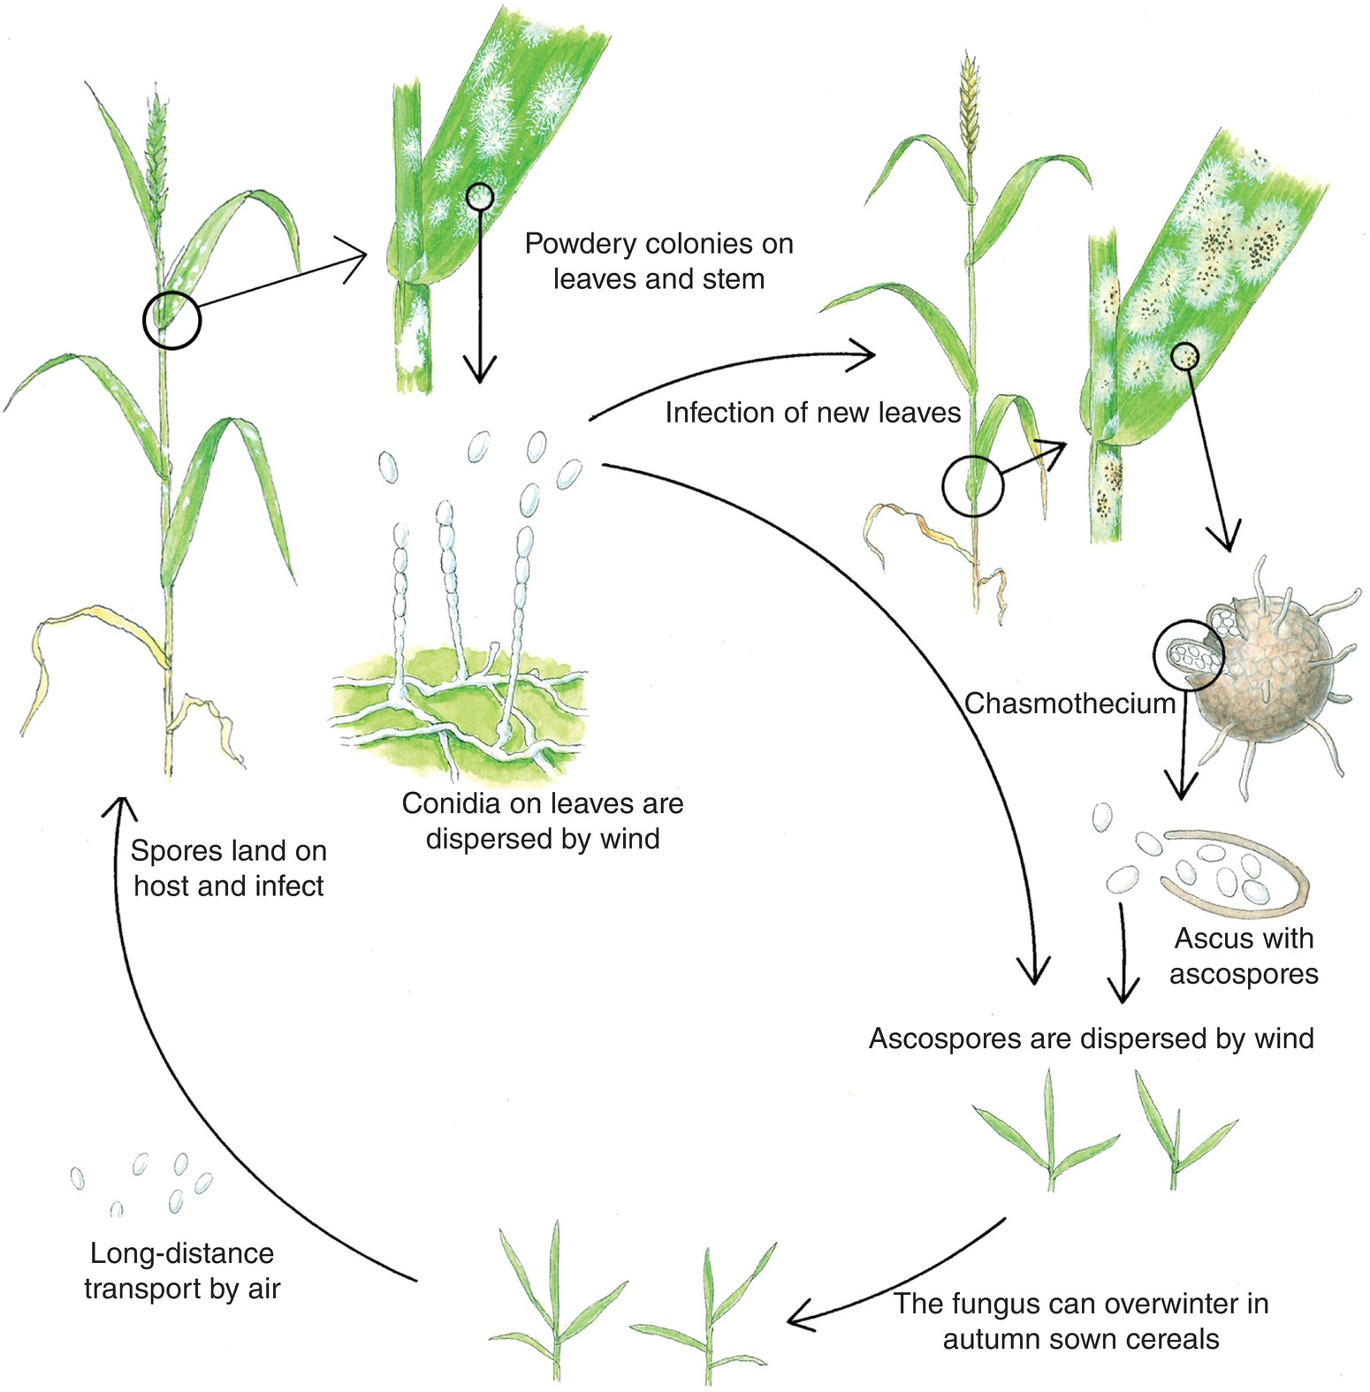
Fig. 4.17 Disease cycle of powdery mildew (Blumeria graminis) in cereals. (H. Karlsen © NIBIO.)
Plant Pathology and Plant Diseases
© Anne Marte Tronsmo, David B. Collinge, Annika Djurle, Lisa Munk, Jonathan Yuen and Arne Tronsmo 2020

Slide 19
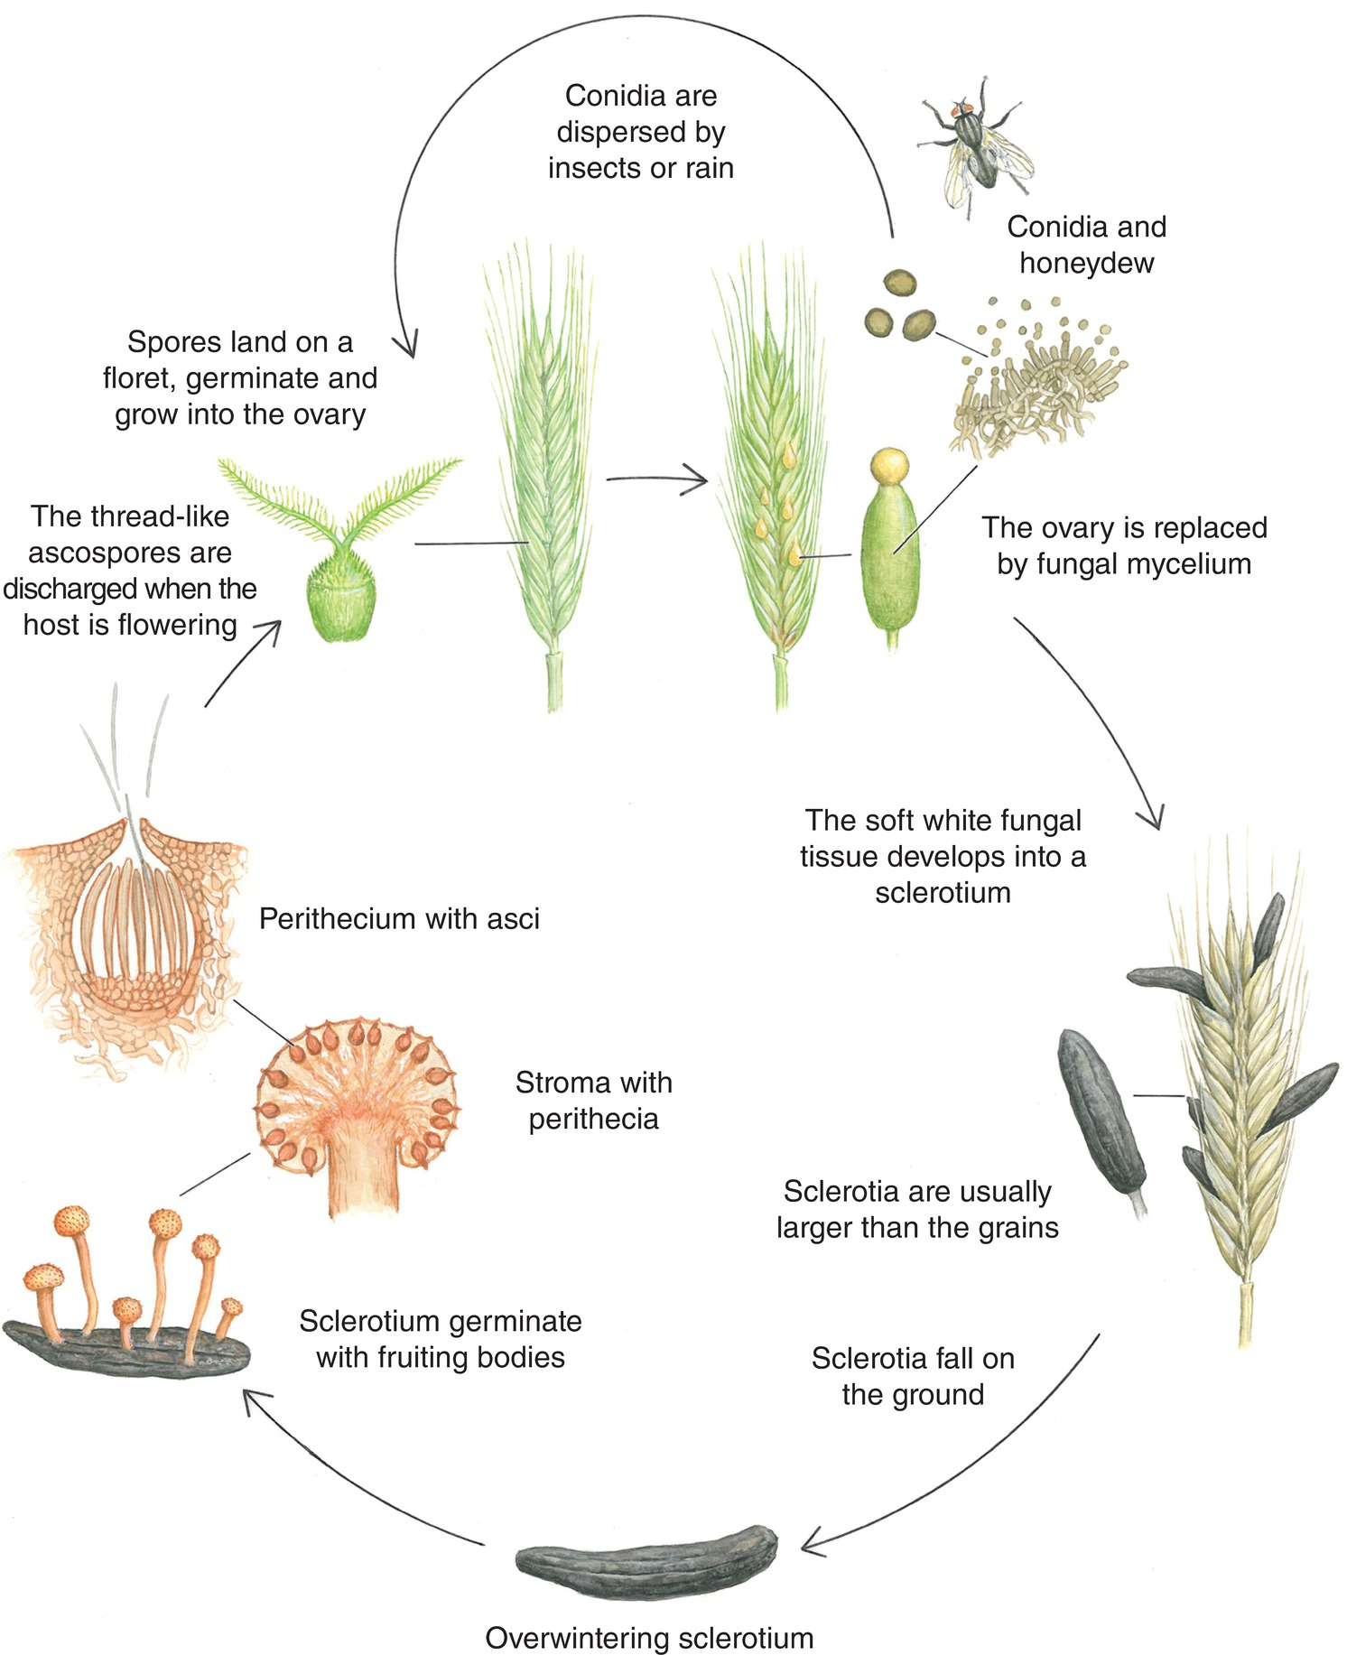
Fig. 4.18 Disease cycle of ergot, caused by Claviceps purpurea. (H. Karlsen © NIBIO.)
Plant Pathology and Plant Diseases
© Anne Marte Tronsmo, David B. Collinge, Annika Djurle, Lisa Munk, Jonathan Yuen and Arne Tronsmo 2020

Slide 20
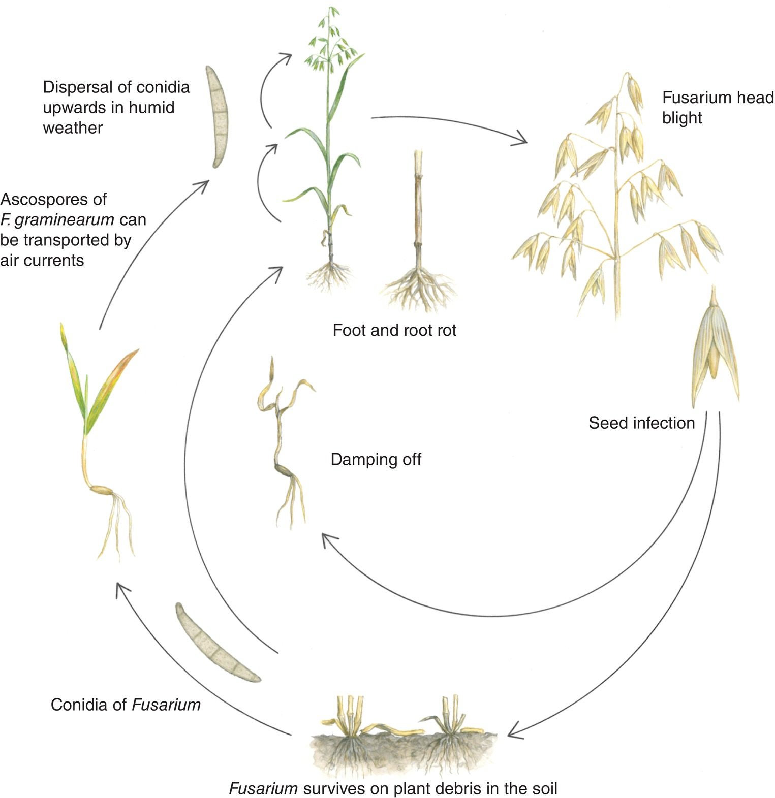
Fig. 4.19 Disease cycle of fusarium head blight in oats. (H. Karlsen © NIBIO.)
Plant Pathology and Plant Diseases
© Anne Marte Tronsmo, David B. Collinge, Annika Djurle, Lisa Munk, Jonathan Yuen and Arne Tronsmo 2020

Slide 21
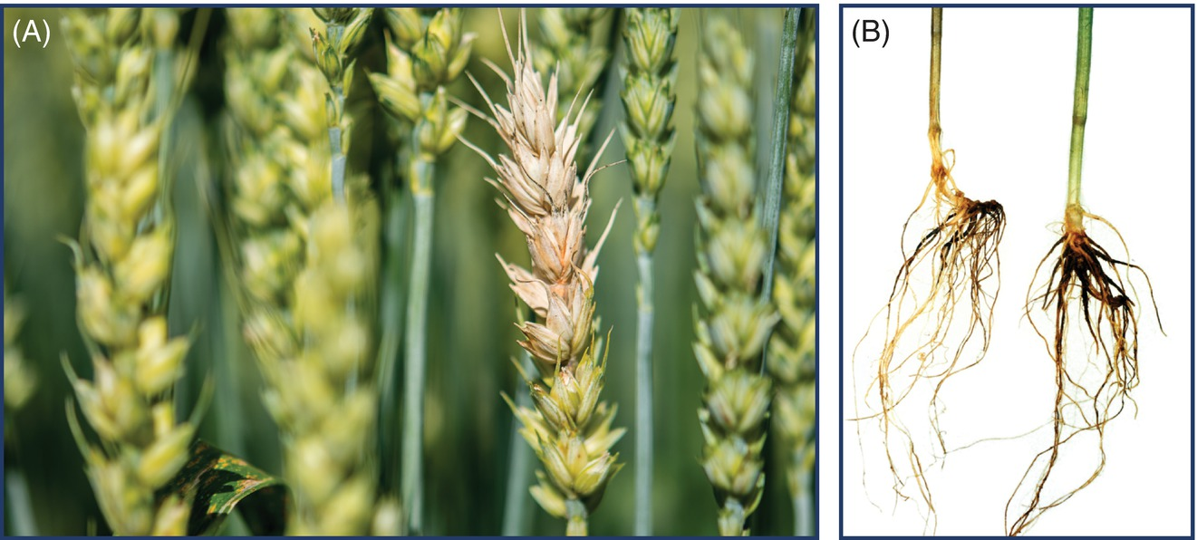
Fig. 4.20 (A) Fusarium head blight in wheat. (© NIBIO.)
(B) Dark and short roots of wheat, caused by the take-all pathogen Gaeumannomyces tritici. (E. Fløistad © NIBIO.)
Plant Pathology and Plant Diseases
© Anne Marte Tronsmo, David B. Collinge, Annika Djurle, Lisa Munk, Jonathan Yuen and Arne Tronsmo 2020

Slide 22
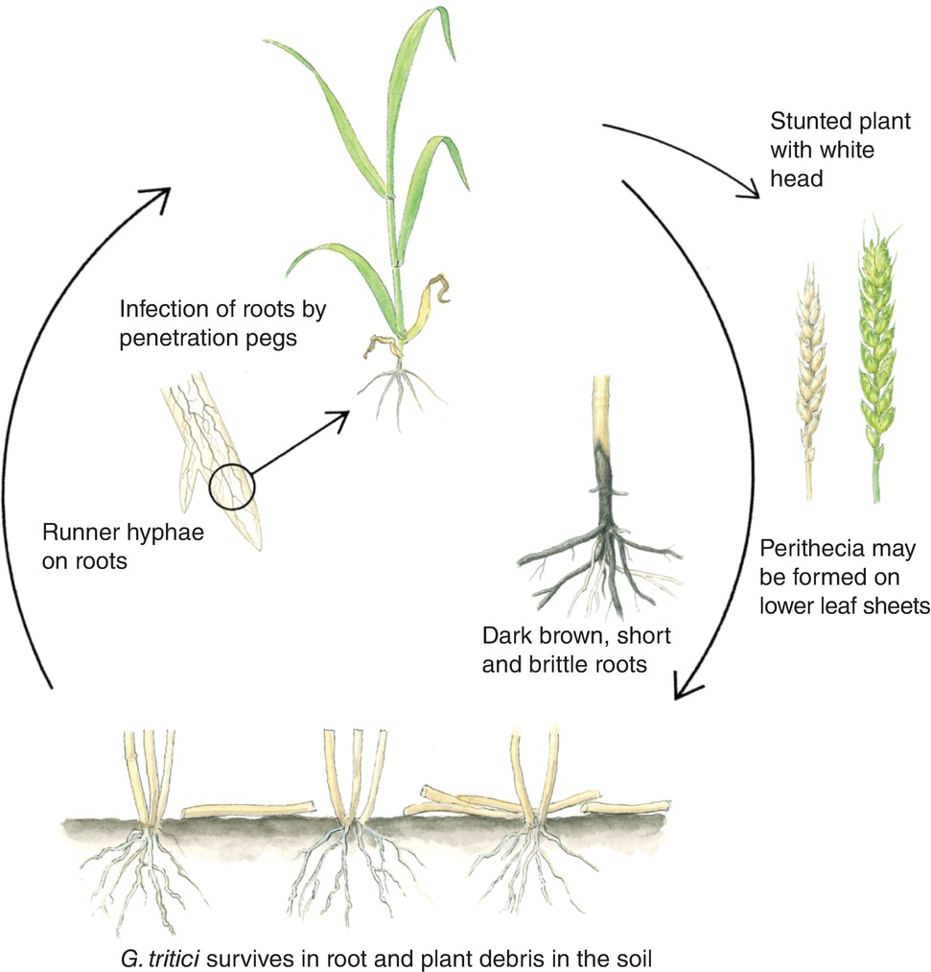
Fig. 4.21 Disease cycle of take-all in wheat caused by Gaeumannomyces tritici. (H. Karlsen © NIBIO.)
Plant Pathology and Plant Diseases
© Anne Marte Tronsmo, David B. Collinge, Annika Djurle, Lisa Munk, Jonathan Yuen and Arne Tronsmo 2020

Slide 23
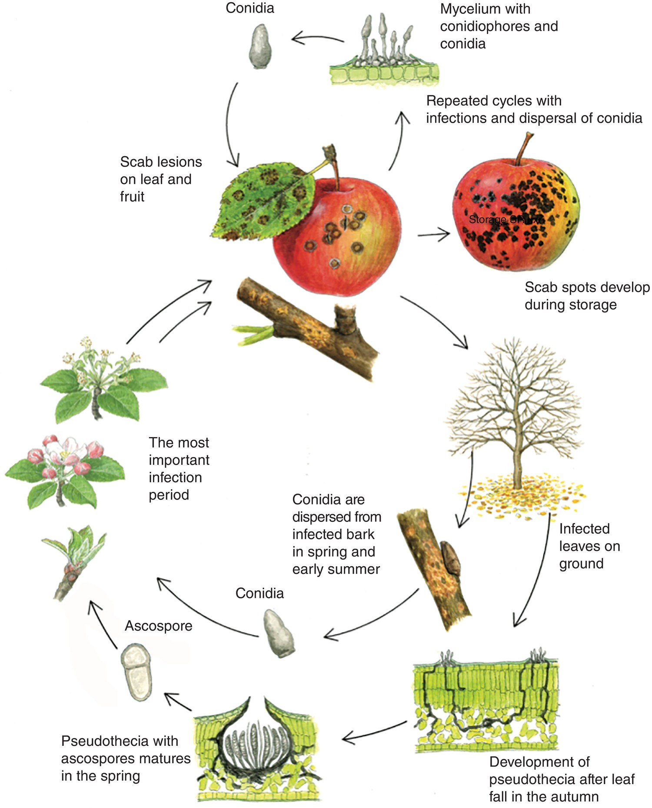
Fig. 4.22 Disease cycle of apple scab (Venturia inaequalis). (H. Karlsen © NIBIO.)
Plant Pathology and Plant Diseases
© Anne Marte Tronsmo, David B. Collinge, Annika Djurle, Lisa Munk, Jonathan Yuen and Arne Tronsmo 2020

Slide 24
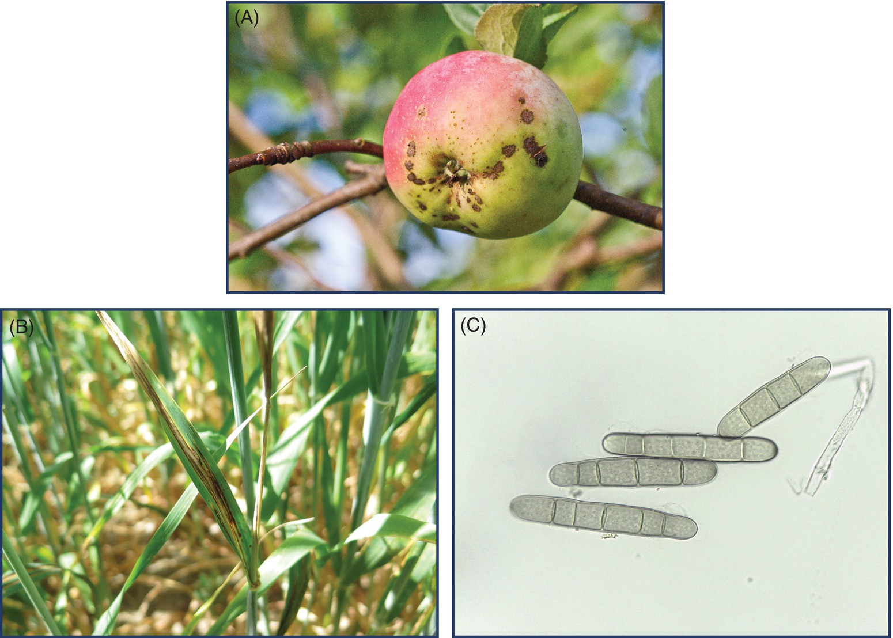
Fig. 4.23 (A) Apple scab ( V. inaequalis) on apple. (E. Fløistad © NIBIO.)
B) Leaf stripe on barley caused by Pyrenophora graminea. (© L. Munk.)
C) Conidia of P. teres. (© L. Munk.)
Plant Pathology and Plant Diseases
© Anne Marte Tronsmo, David B. Collinge, Annika Djurle, Lisa Munk, Jonathan Yuen and Arne Tronsmo 2020

Slide 25
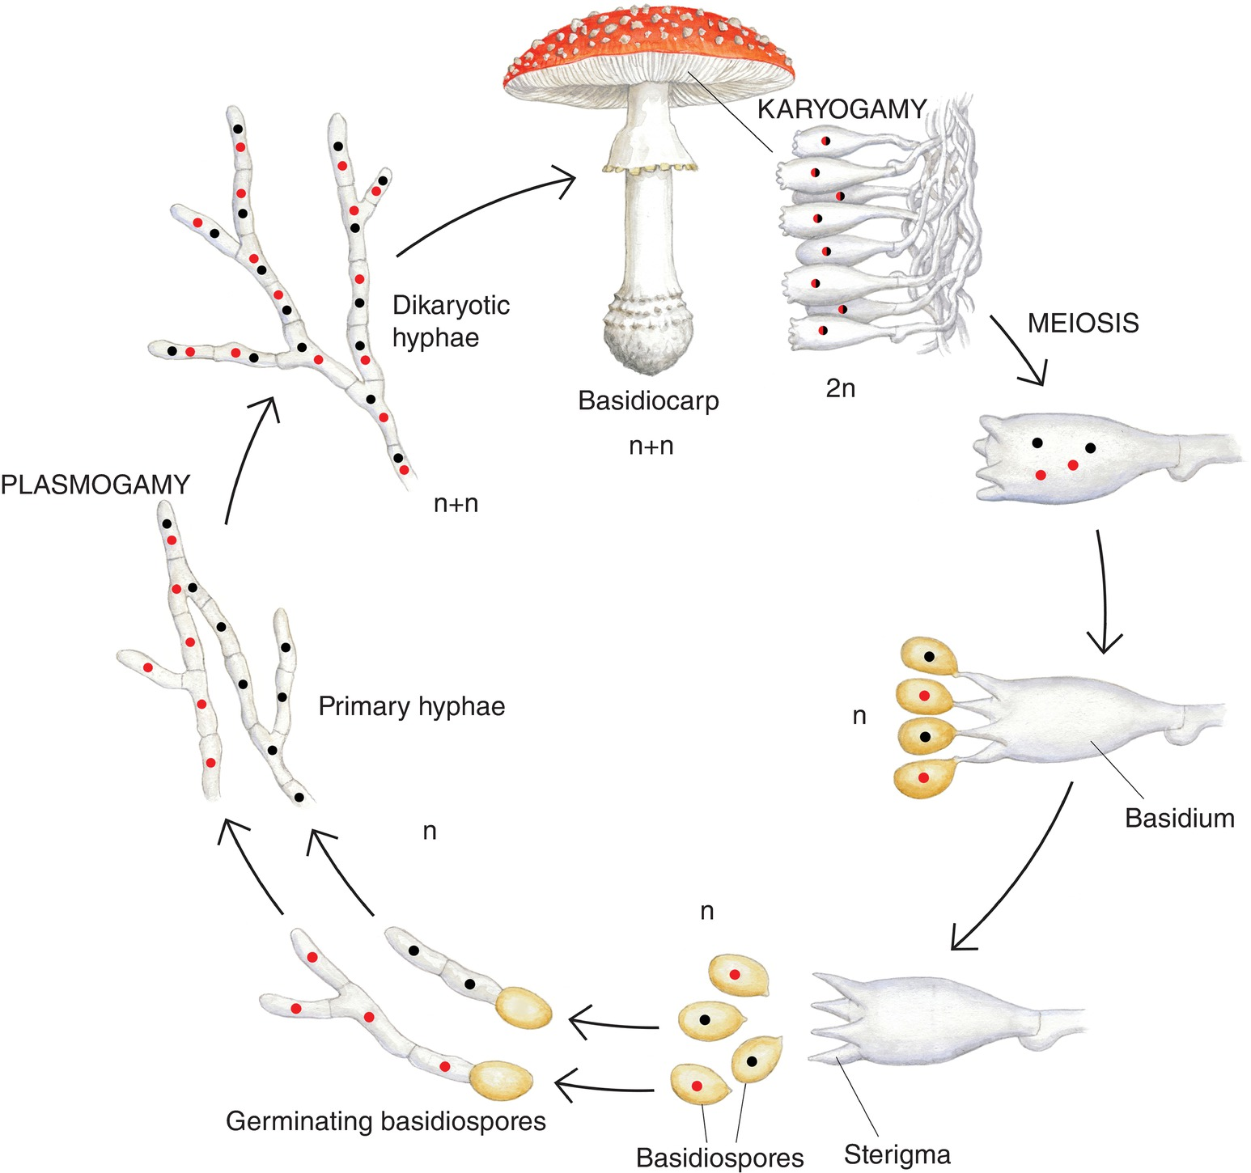
Fig. 4.24 Life cycle of a basidiomycete. (© H. Karlsen.)
Plant Pathology and Plant Diseases
© Anne Marte Tronsmo, David B. Collinge, Annika Djurle, Lisa Munk, Jonathan Yuen and Arne Tronsmo 2020

Slide 26
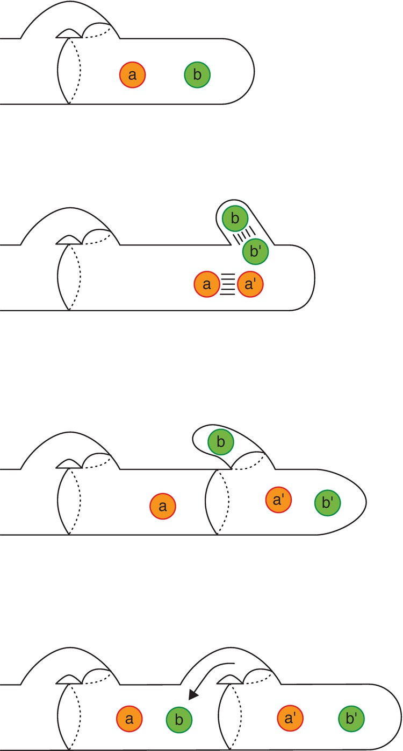
Fig. 4.25 Creation of a clamp connection in Basidiomycota. (Attribution: Jagriff at English Wikipedia. Slightly modified.)
Plant Pathology and Plant Diseases
© Anne Marte Tronsmo, David B. Collinge, Annika Djurle, Lisa Munk, Jonathan Yuen and Arne Tronsmo 2020

Slide 27
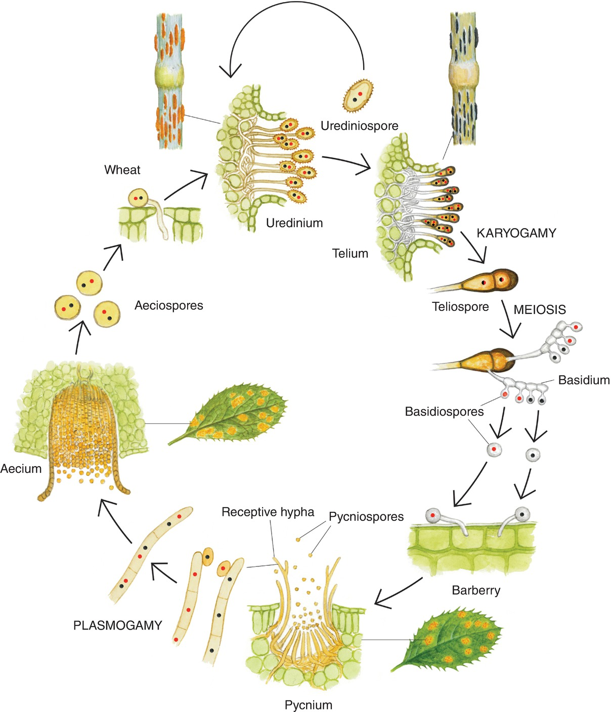
Fig. 4.26 Disease cycle of stem rust (Puccinia graminis). (© H. Karlsen)
Plant Pathology and Plant Diseases
© Anne Marte Tronsmo, David B. Collinge, Annika Djurle, Lisa Munk, Jonathan Yuen and Arne Tronsmo 2020

Slide 28
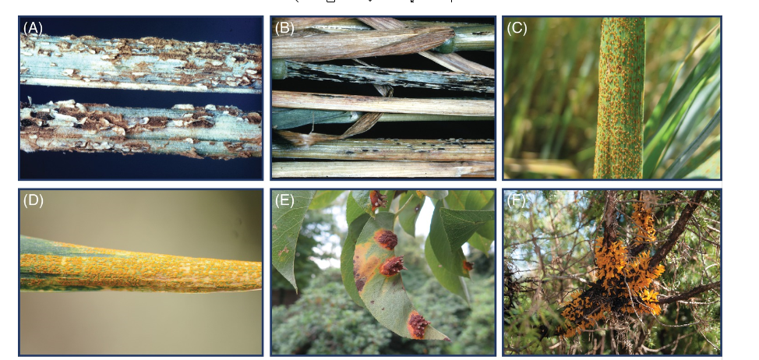
Fig. 4.27 A-F Some rust diseases. (A) The uredinial stage of stem rust (P. graminins) on wheat. (B) The telial stage of stem rust (P. graminis) on oats. (C) Brown rust (P. triticina) on wheat. (D) Yellow rust (P. striiformis) on wheat. (E) Pear rust (Gymnosporangium sabinae). (F) Hawthorn rust (Gymnosporangium clavariiforme) on juniper. (A,B: © SLU; C,E,: © L. Munk; D: © D.B. Collinge; F: E. Fløistad © NIBIO.)
Plant Pathology and Plant Diseases
© Anne Marte Tronsmo, David B. Collinge, Annika Djurle, Lisa Munk, Jonathan Yuen and Arne Tronsmo 2020

Slide 29
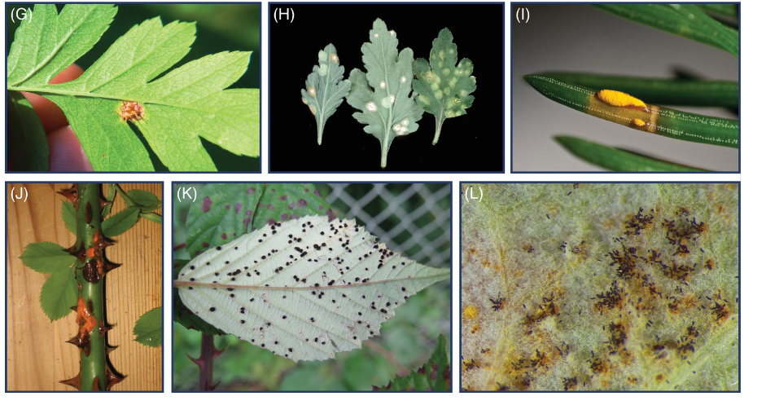
Fig. 4.27 G-L Some rust diseases. (G) Gymnosporangium clavariiforme on hawthorn. (H) White rust (P. horiana) of chrysanthemum. (I) Spruce needle rust caused by Chrysomyxa abietis. (J) Phragmidium tuberculatum on rose. (K) Phragmidium violaceum on blackberry (Rubus fruticosus). (L) Phragmidium rubi-idaei on raspberry (Rubus idaeus). (G,J,K,L: © L. Munk; H: H.B. Gjærum © NIBIO; I: E. Fløistad © NIBIO)
Plant Pathology and Plant Diseases
© Anne Marte Tronsmo, David B. Collinge, Annika Djurle, Lisa Munk, Jonathan Yuen and Arne Tronsmo 2020

Slide 30
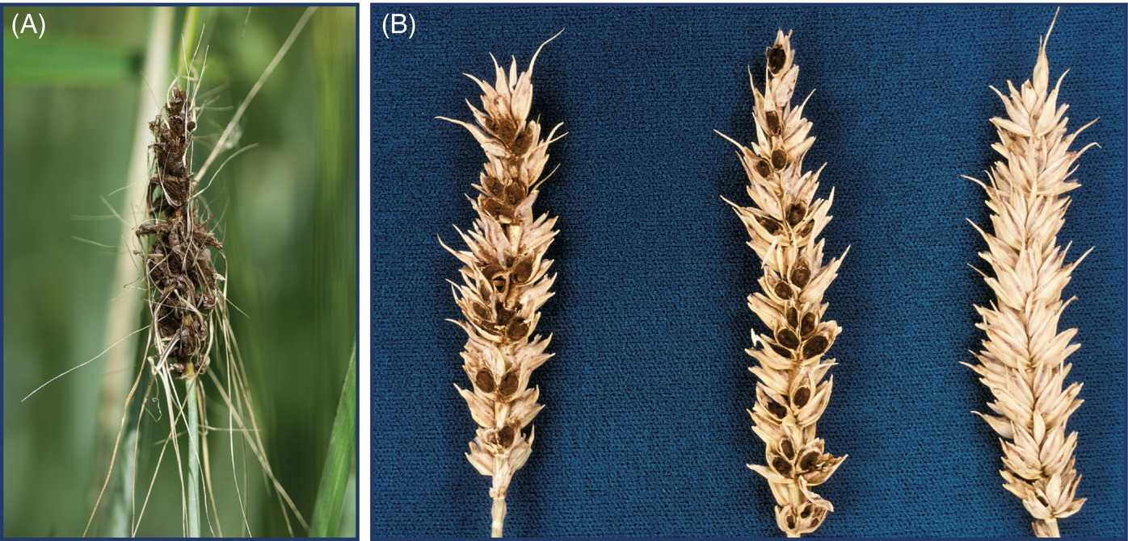
Fig. 4.28 Smut and bunt. (A) Loose smut (Ustilago nuda) on barley. (B) Bunt (covered smut/stinking bunt), caused by Tilletia tritici in wheat.
(A: E. Fløistad; B: R. Langnes,© NIBIO.)
Plant Pathology and Plant Diseases
© Anne Marte Tronsmo, David B. Collinge, Annika Djurle, Lisa Munk, Jonathan Yuen and Arne Tronsmo 2020

Slide 31
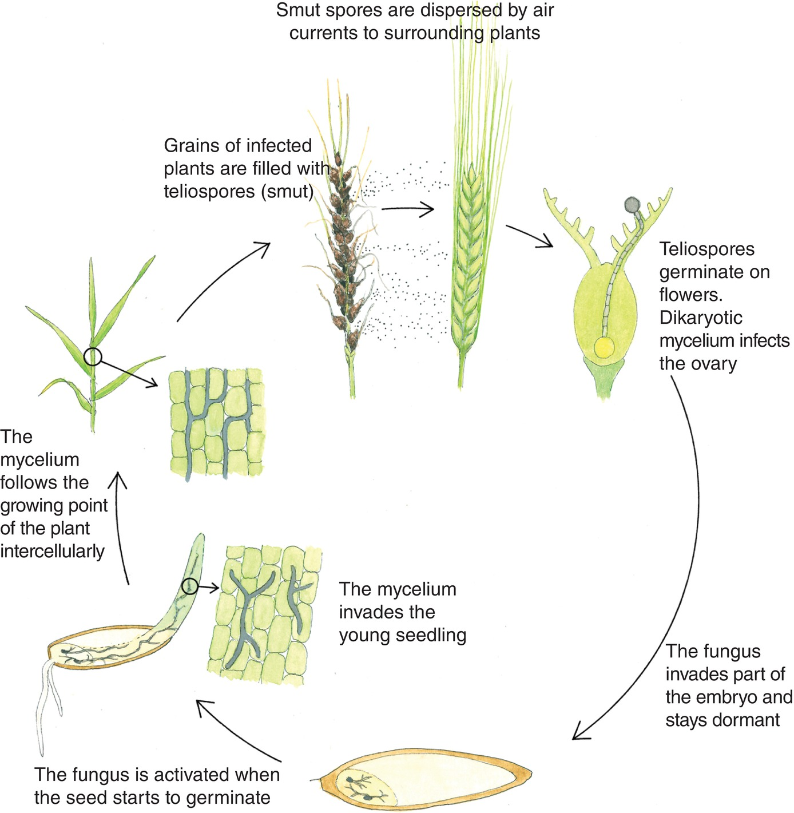
Fig. 4.29 Disease cycle of loose smut caused by Ustilago nuda in barley. (H. Karlsen © NIBIO.)
Plant Pathology and Plant Diseases
© Anne Marte Tronsmo, David B. Collinge, Annika Djurle, Lisa Munk, Jonathan Yuen and Arne Tronsmo 2020

Slide 32
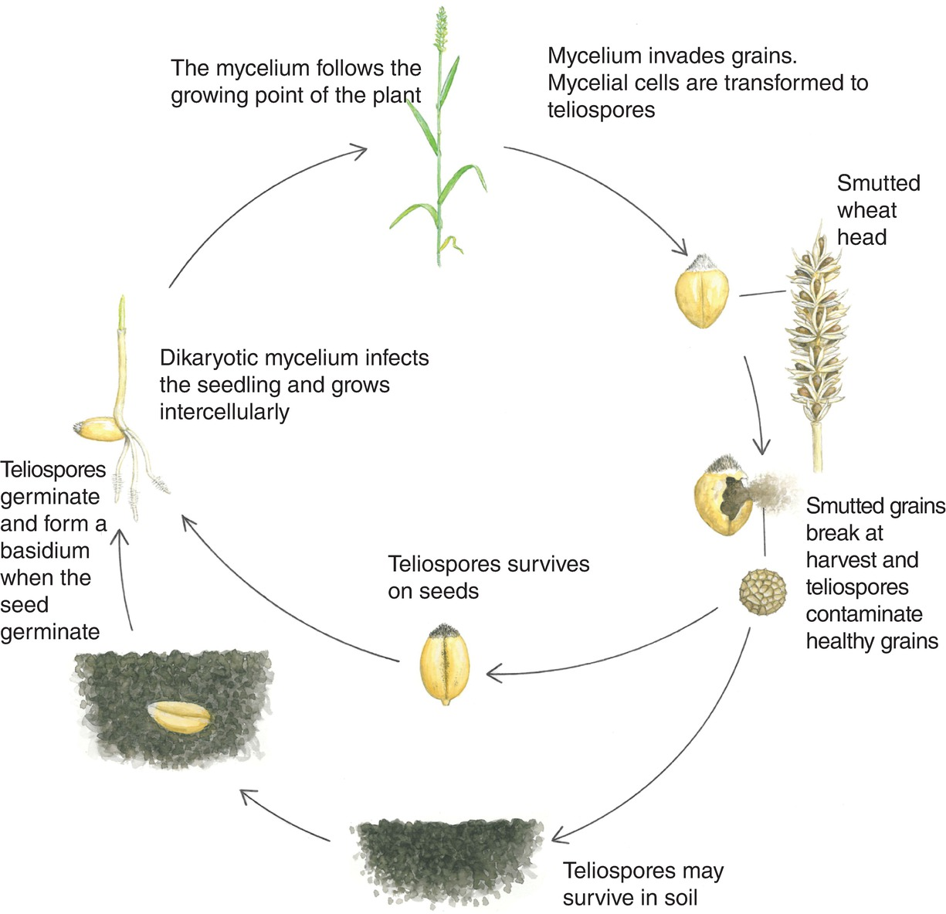
Fig. 4.30 Disease cycle of common bunt on wheat, caused by Tilletia tritici. (H. Karlsen © NIBIO.)
Plant Pathology and Plant Diseases
© Anne Marte Tronsmo, David B. Collinge, Annika Djurle, Lisa Munk, Jonathan Yuen and Arne Tronsmo 2020

Slide 33
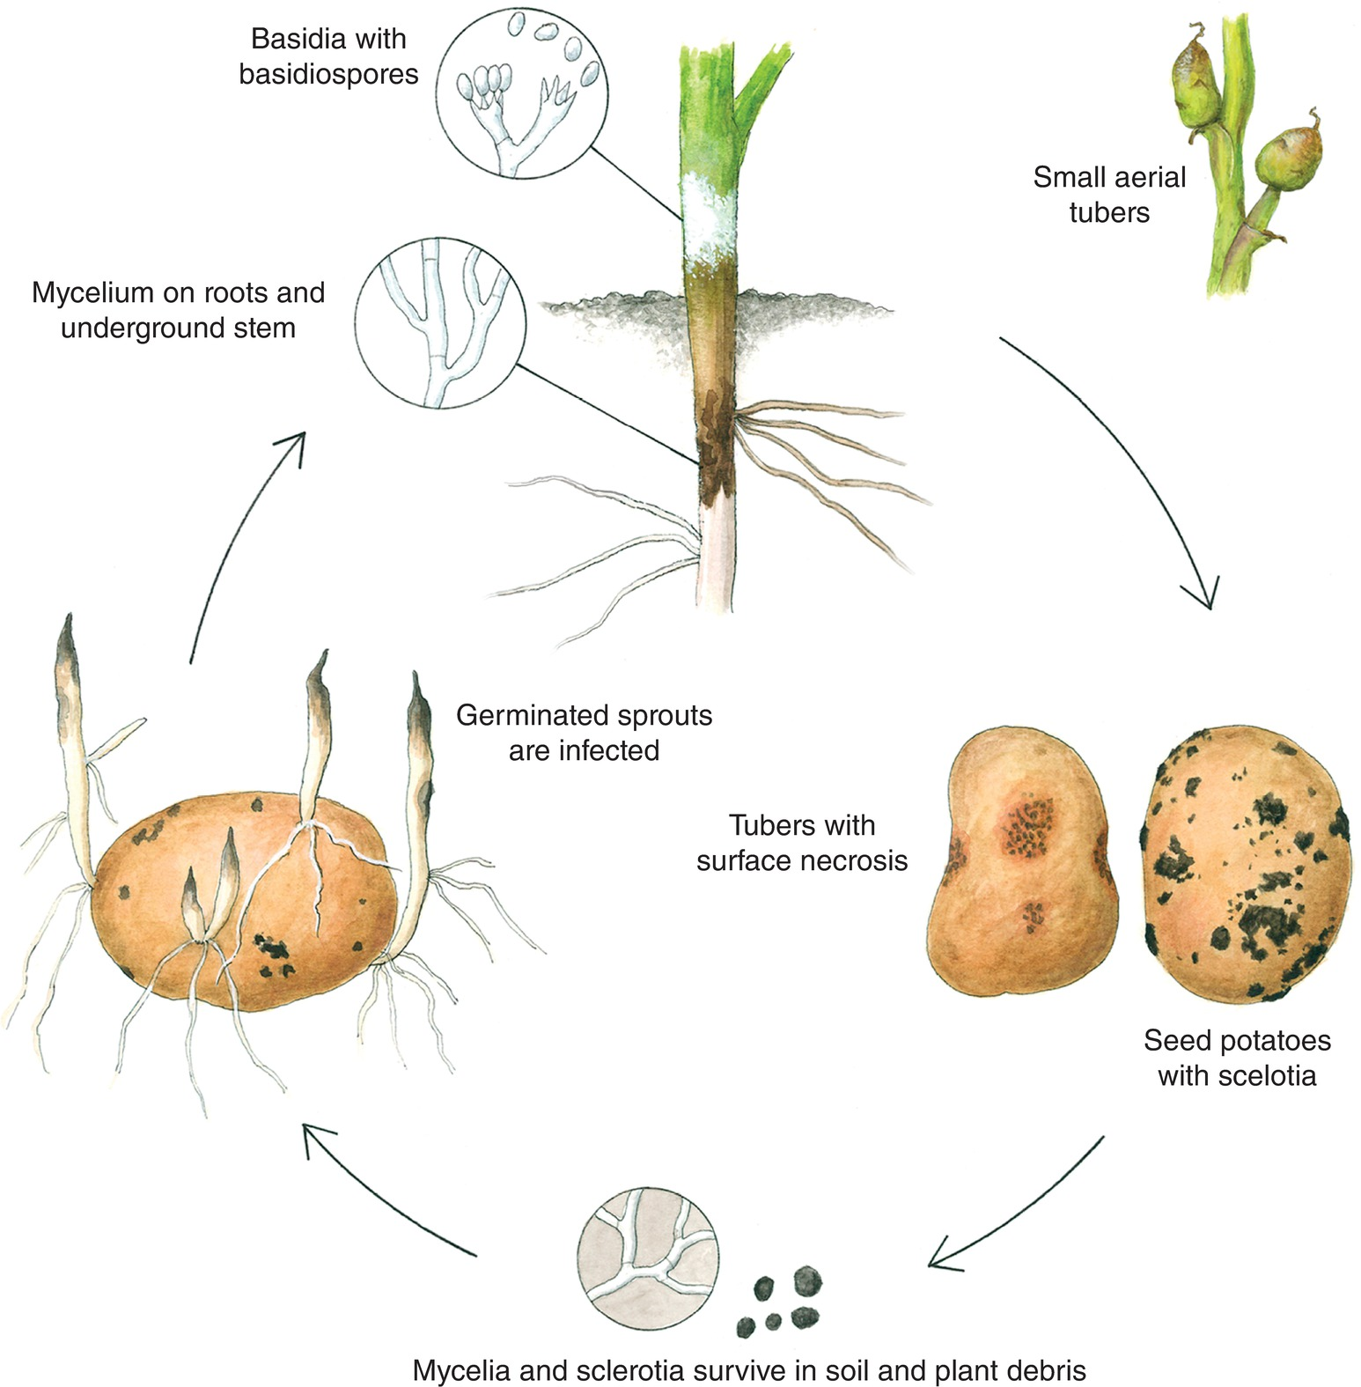
Fig. 4.31 The disease cycle black scurf (Rhizoctonia solani) on potato. (H. Karlsen © NIBIO.)
Plant Pathology and Plant Diseases
© Anne Marte Tronsmo, David B. Collinge, Annika Djurle, Lisa Munk, Jonathan Yuen and Arne Tronsmo 2020

Slide 34
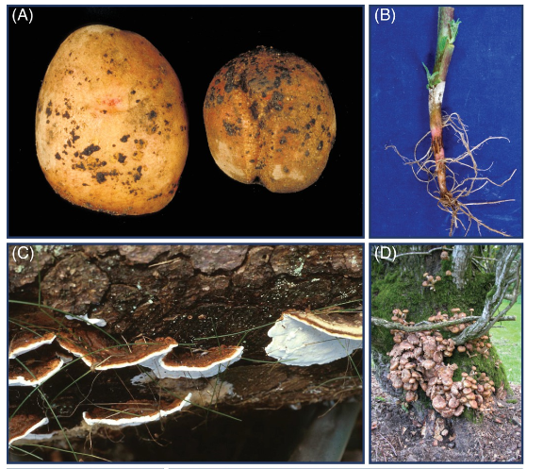
Fig. 4.32 A-D Diseases caused by Agaricomycetes. (A) Black scurf (Rhizoctonia solani), on potato tubers. (R. Langnes © NIBIO.)
(B) The basidial stage of Rhizoctonia solani on potato stem. (V. Hjønnevåg,© NIBIO.)
(C) Heterobasidion annosum on Norway spruce. (F. Roll-Hansen © NIBIO.)
(D) A wilting oak tree with mushrooms (fruiting bodies) of Armillaria spp. on the stem. (A: R. Langnes © NIBIO; B: V. Hjønnevåg © NIBIO; C: F. Roll-Hansen © NIBIO; D: V. Talgø © NIBIO.)
Plant Pathology and Plant Diseases
© Anne Marte Tronsmo, David B. Collinge, Annika Djurle, Lisa Munk, Jonathan Yuen and Arne Tronsmo 2020

Slide 35
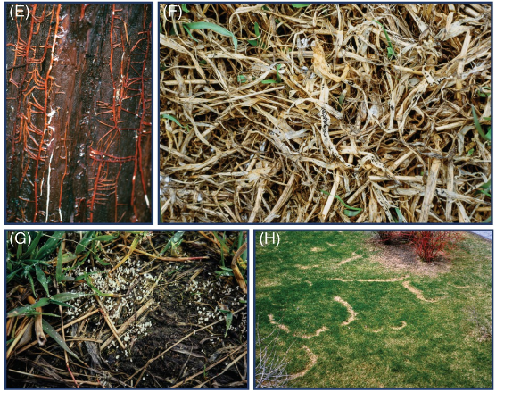
Fig. 4.32 E-H Diseases caused by Agaricomycetes.
(E) Rhizomorphs of Armillaria spp. (F. Roll-Hansen © NIBIO.)
(F)Sclerotia of Typhula ishikariensis on timothy after snow melt in spring. (S. Svendsen© NIBIO.)
(G) Basidia of T. ishikariensis in a timothy field in late autumn. (K. Årsvoll © NIBIO.)
(H) Fairy rings caused by Marasmius oreades. (E: F. Roll-Hansen © NIBIO; F: S. Svendsen © NIBIO; G: K. Årsvoll © NIBIO; H: H. B. Gjærum© NIBIO.)
Plant Pathology and Plant Diseases
© Anne Marte Tronsmo, David B. Collinge, Annika Djurle, Lisa Munk, Jonathan Yuen and Arne Tronsmo 2020

