Slide 1
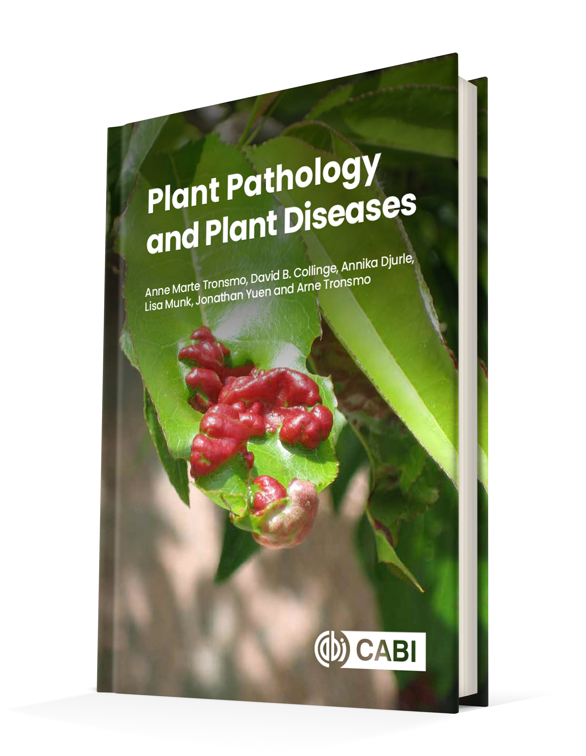
Plant Pathology and Plant Diseases
© Anne Marte Tronsmo, David B. Collinge, Annika Djurle, Lisa Munk, Jonathan Yuen and Arne Tronsmo 2020

Slide 2
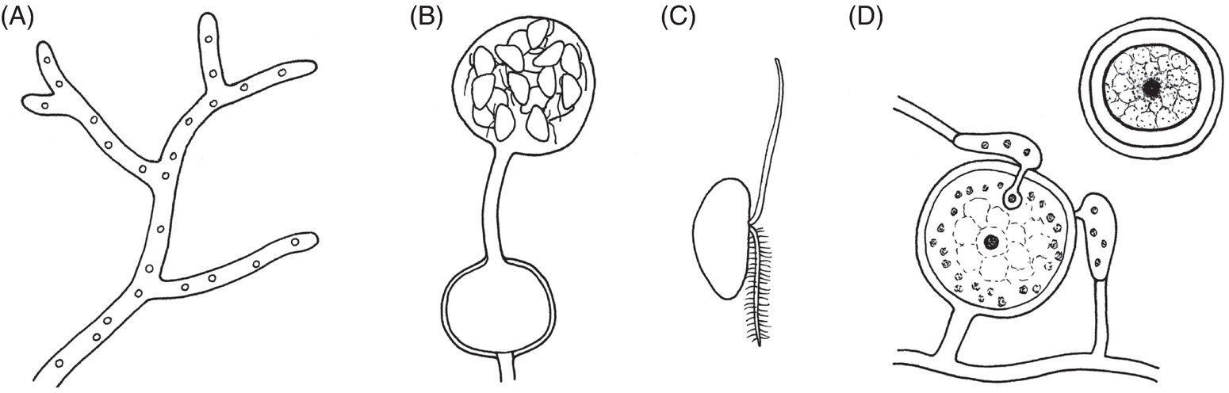
Fig. 5.1 Characteristic structures for oomycetes. (A) The hyphae lack transverse walls. (B) Zoosporangium. (C) Biflagellate zoospores. (D) Fertilization of an oogonium by antheridia; and oospore. (© H. Karlsen.)
Plant Pathology and Plant Diseases © Anne Marte Tronsmo, David B. Collinge, Annika Djurle, Lisa Munk, Jonathan Yuen and Arne Tronsmo 2020

Slide 3
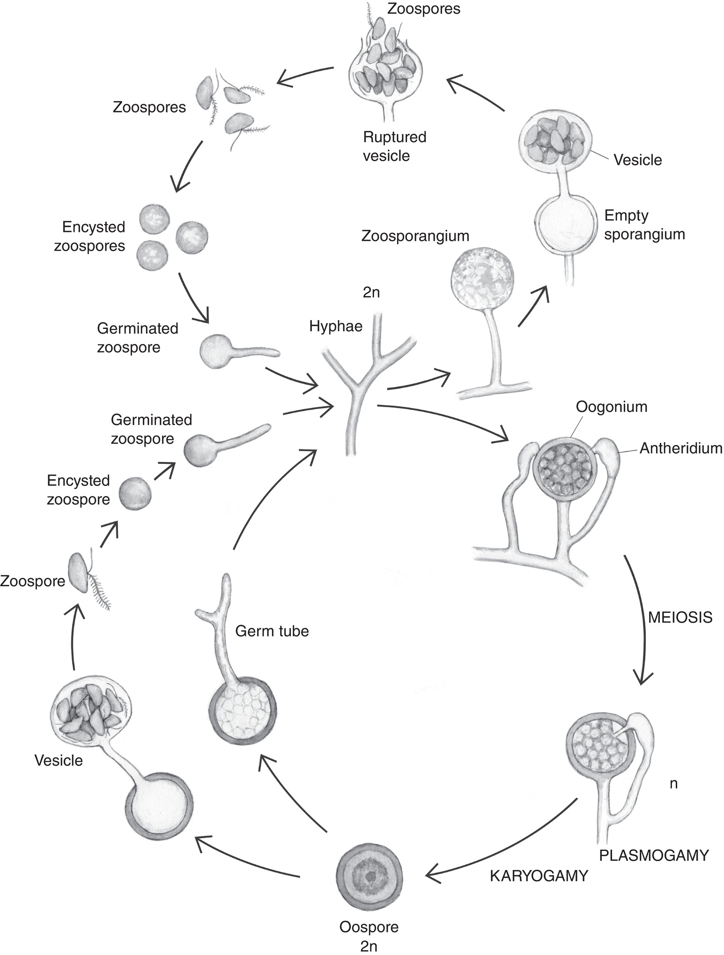
Fig. 5.2 Life cycle of an oomycete (Pythium sp.). (© H. Karlsen.)
Plant Pathology and Plant Diseases © Anne Marte Tronsmo, David B. Collinge, Annika Djurle, Lisa Munk, Jonathan Yuen and Arne Tronsmo 2020

Slide 4
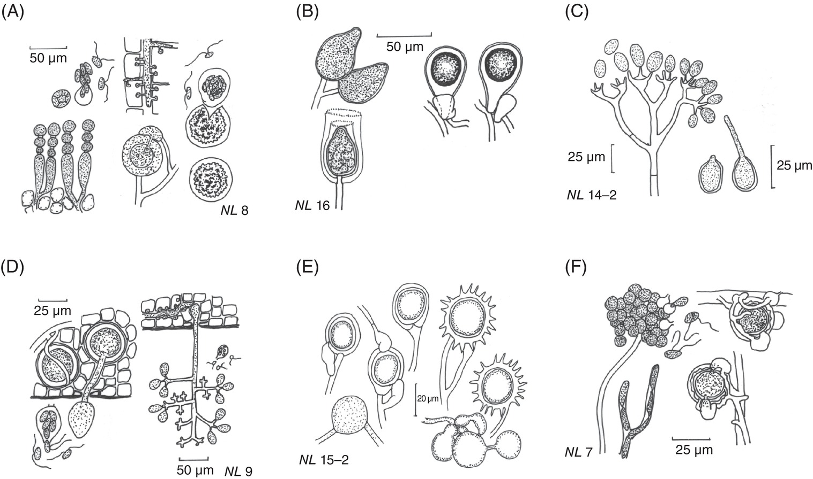
Fig. 5.3 Sexual and asexual structures of genera in Peronosporea. (A) Albugo candida. (B) Phytophthora fragariae var. fragariae. (C) Bremia lactucae. (D) Plasmopara viticola. (E) Pythium (left: P. ultimum; right: P. oligandrum). (F) Aphanomyces euteiches. (N. Leroul, courtesy of J. Hockenhull et al.)
Plant Pathology and Plant Diseases © Anne Marte Tronsmo, David B. Collinge, Annika Djurle, Lisa Munk, Jonathan Yuen and Arne Tronsmo 2020

Slide 5
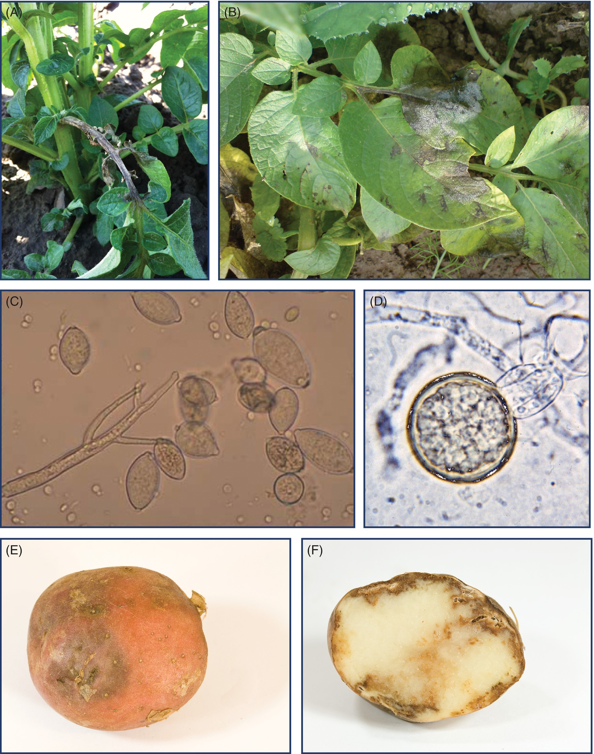
Fig. 5.4 A-B Phytophthora infestans symptoms and signs on potato. (A) Necrotic tissue on potato stalk. (B) Potato leaf with sporulating P. infestans. (© B. Anderson.)
Plant Pathology and Plant Diseases © Anne Marte Tronsmo, David B. Collinge, Annika Djurle, Lisa Munk, Jonathan Yuen and Arne Tronsmo 2020

Slide 6
Fig. 5.4 C-D Phytophthora infestans symptoms and signs on potato. (C) Sporangia of P. infestans. (D) An oospore of P. infestans. (© B. Anderson.)
Plant Pathology and Plant Diseases © Anne Marte Tronsmo, David B. Collinge, Annika Djurle, Lisa Munk, Jonathan Yuen and Arne Tronsmo 2020

Slide 7
Fig. 5.4 E-F Phytophthora infestans symptoms and signs on potato. (E) Infected potato tuber. (F) Transverse section of an infected potato. (E-F: E. Fløistad © NIBIO.)
Plant Pathology and Plant Diseases © Anne Marte Tronsmo, David B. Collinge, Annika Djurle, Lisa Munk, Jonathan Yuen and Arne Tronsmo 2020

Slide 8
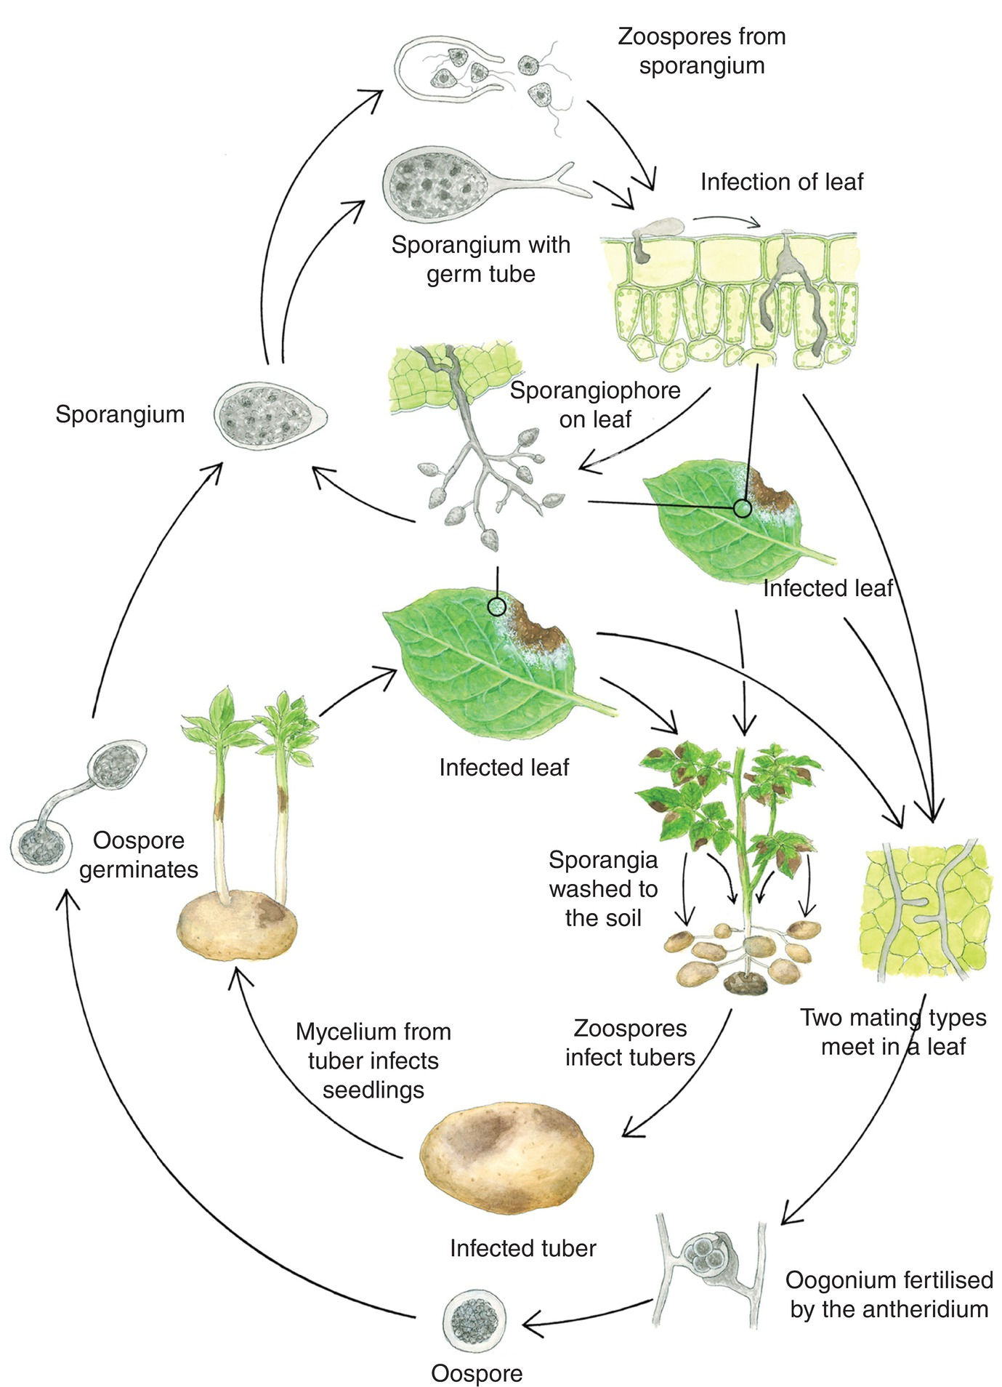
Fig. 5.5 Disease cycle of Phytophthora infestans on potato, with the outer circle showing the sexual stage of the pathogen. (H. Karlsen © NIBIO.)
Plant Pathology and Plant Diseases © Anne Marte Tronsmo, David B. Collinge, Annika Djurle, Lisa Munk, Jonathan Yuen and Arne Tronsmo 2020

Slide 9
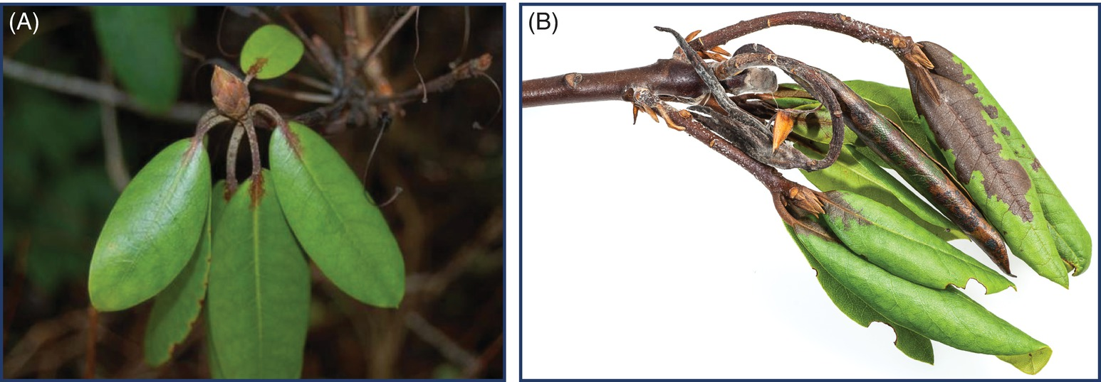
Fig. 5.6 Ramorum dieback caused by Phytophthora ramorum in rhododendron. (A) Bud and (B) stems and leaves.
(A: © B. Toppe; B: E. Fløistad © NIBIO.)
Plant Pathology and Plant Diseases © Anne Marte Tronsmo, David B. Collinge, Annika Djurle, Lisa Munk, Jonathan Yuen and Arne Tronsmo 2020

Slide 10
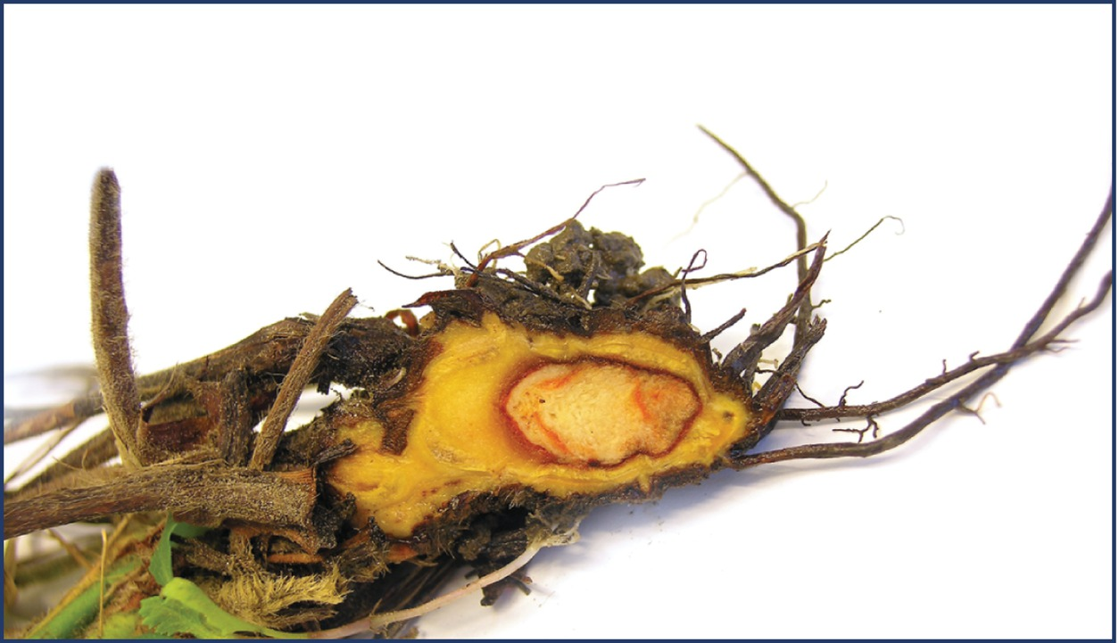
Fig. 5.7 Symptoms of red core in strawberry caused by Phytophthora fragariae. (H.M. Singh © NIBIO.)
Plant Pathology and Plant Diseases © Anne Marte Tronsmo, David B. Collinge, Annika Djurle, Lisa Munk, Jonathan Yuen and Arne Tronsmo 2020

Slide 11
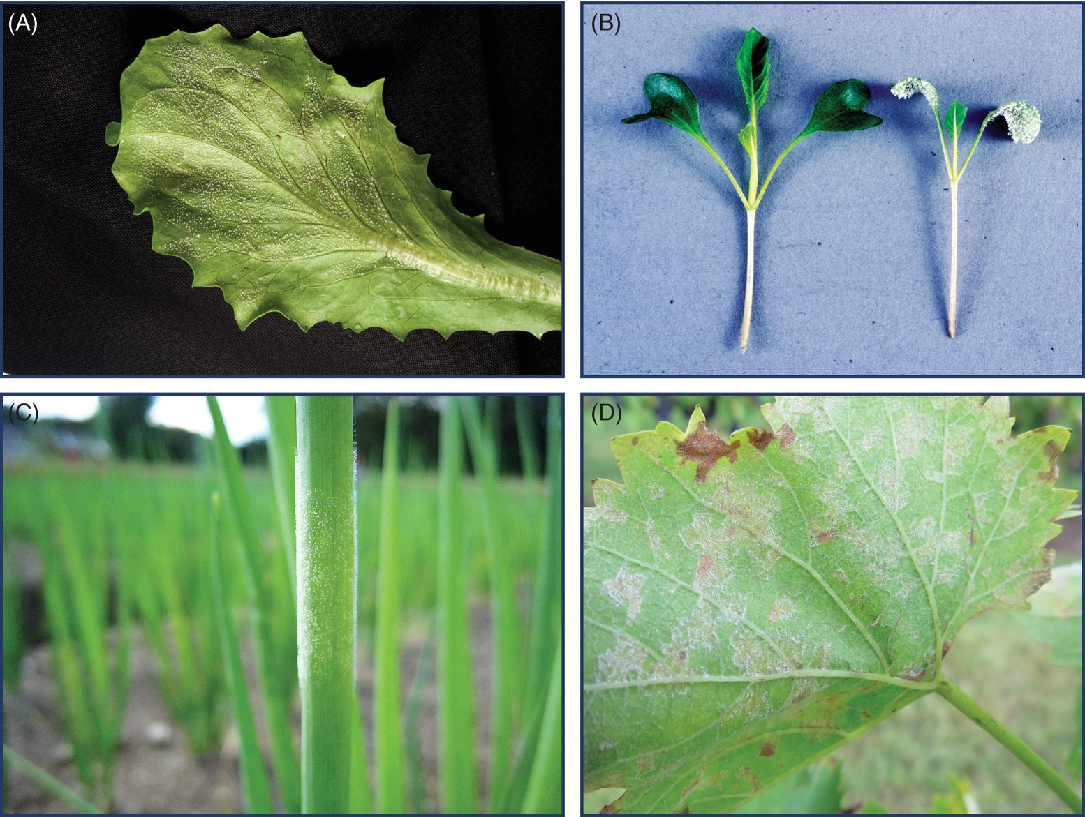
Fig. 5.8 Downy mildews. (A) Bremia lactucae on lettuce. (B) Hyaloperonospora parasitica on Brassica oleracea seedlings. (C) Peronospora destructor on onions. (D) Plasmopara viticola on vine.
(A: E. Fløistad © NIBIO; B: B. Dahl Jensen © NIBIO; C: A. Hermansen © NIBIO; D: © L. Munk.)
Plant Pathology and Plant Diseases © Anne Marte Tronsmo, David B. Collinge, Annika Djurle, Lisa Munk, Jonathan Yuen and Arne Tronsmo 2020

Slide 12
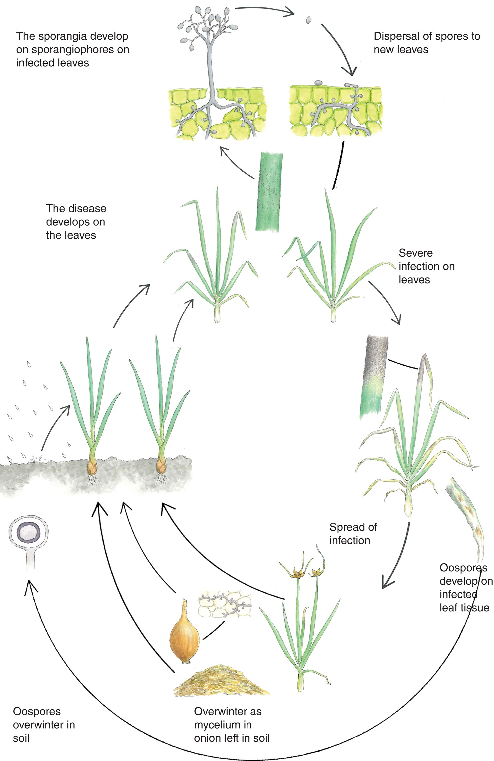
Fig. 5.9 Disease cycle of downy mildew (Peronospora destructor) on onion.
( H. Karlsen © NIBIO.)
Plant Pathology and Plant Diseases © Anne Marte Tronsmo, David B. Collinge, Annika Djurle, Lisa Munk, Jonathan Yuen and Arne Tronsmo 2020

Slide 13
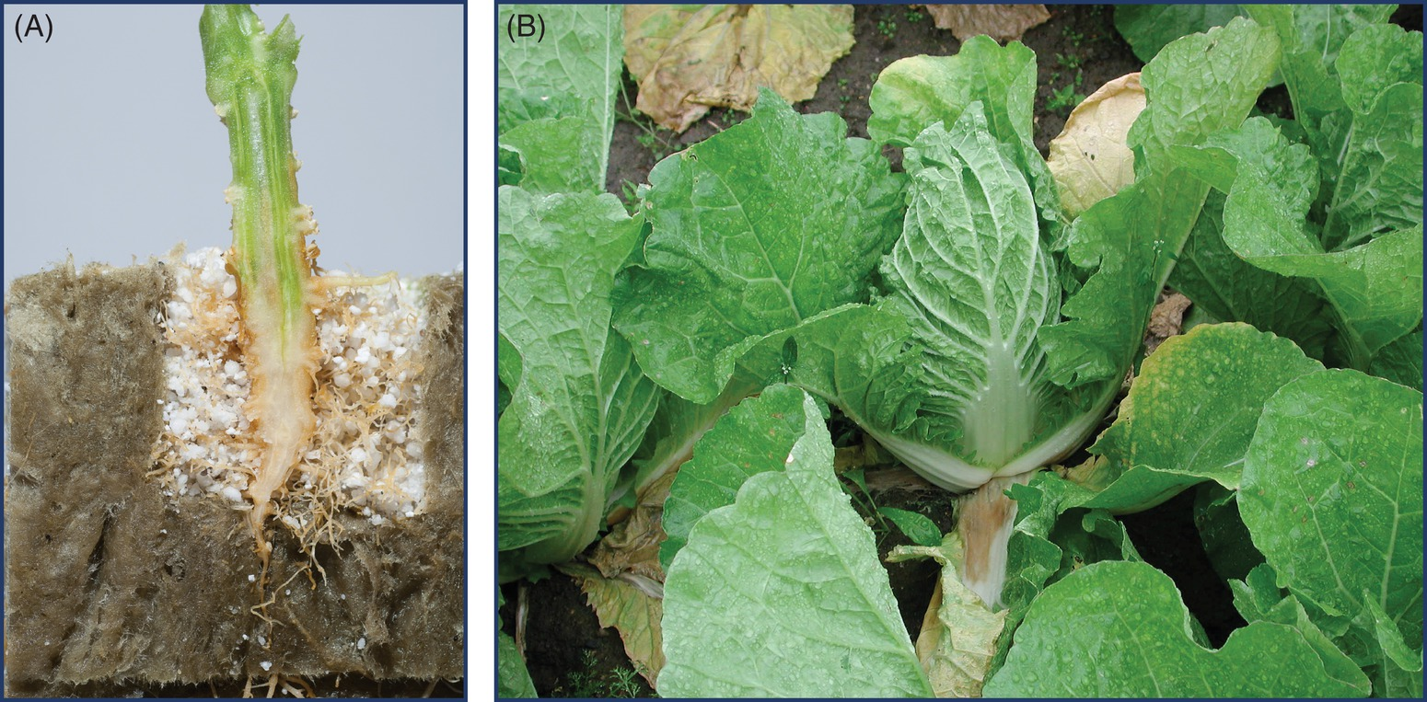
Fig. 5.10 Diseases caused by Pythium. (A) Pythium root rot, caused by P. aphanidermatum, in cucumber. (B) Shoulder rot, caused by P. tracheiphilum in Chinese cabbage. (A: E. Fløistad © NIBIO; B: A. Hermansen © NIBIO.)
Plant Pathology and Plant Diseases © Anne Marte Tronsmo, David B. Collinge, Annika Djurle, Lisa Munk, Jonathan Yuen and Arne Tronsmo 2020

Slide 14
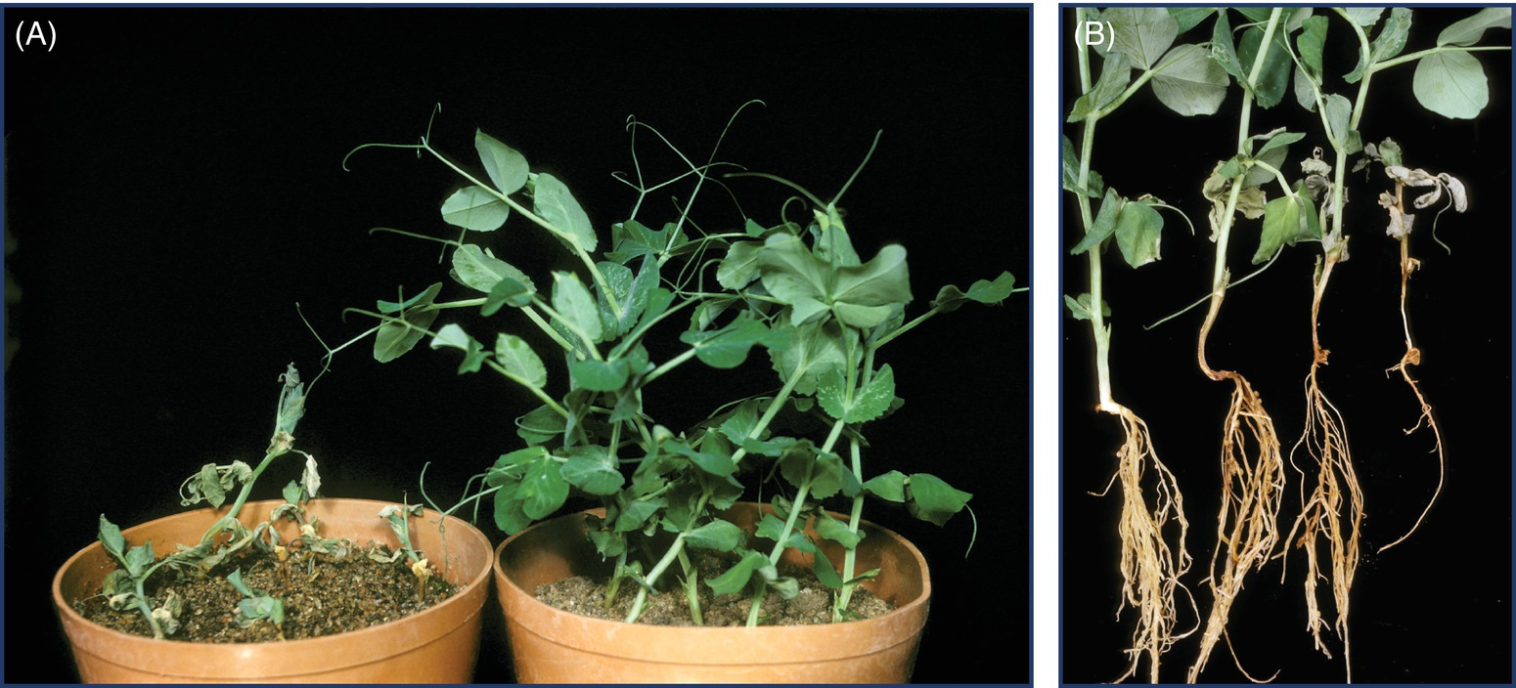
Fig. 5.11 (A) Pea plants infected with Aphanomyces euteiches (left) and healthy pea plants right). (B) Pea plants showing varying degree of root injury after infection with Aphanomyces euteiches. (A-B: L. Sundheim © NIBIO.)
Plant Pathology and Plant Diseases © Anne Marte Tronsmo, David B. Collinge, Annika Djurle, Lisa Munk, Jonathan Yuen and Arne Tronsmo 2020

Slide 15
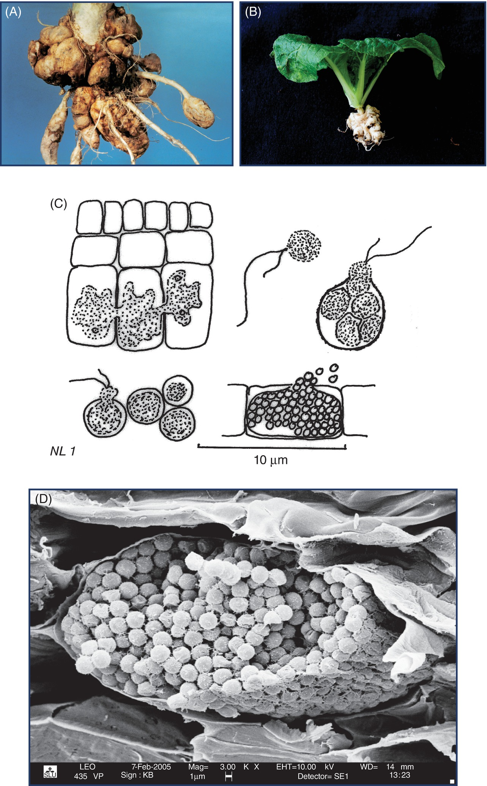
Fig. 5.12 A-B Clubroot symptoms in: (A) Swede and (B) Chinese cabbage. ( A-B: E. Fløistad © NIBIO).
Plant Pathology and Plant Diseases © Anne Marte Tronsmo, David B. Collinge, Annika Djurle, Lisa Munk, Jonathan Yuen and Arne Tronsmo 2020

Slide 16
Fig. 5.12 C-D Clubroot symptoms (C) Plasmodiophora brassicae structures: clockwise from top left: plasmodium in root cells, zoospore, sporangium with zoospores, resting spores being released from host cell, resting spores, and a single zoospore (primary zoospore) developed from a resting spore. (D) Electron micrograph of resting spores of Plasmodiophora brassicae in host cells.
(C: N. Leroul, courtesy of J. Hockenhull et al.; D: K. Brismar and S. Marttila, © SLU.)
Plant Pathology and Plant Diseases © Anne Marte Tronsmo, David B. Collinge, Annika Djurle, Lisa Munk, Jonathan Yuen and Arne Tronsmo 2020

Slide 17
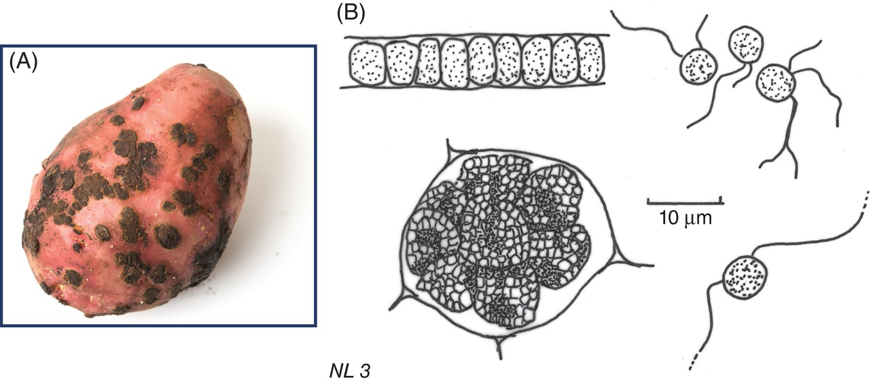
Fig. 5.13 Spongospora subterranea. (A) Symptoms and signs (‘powder’ of spores) on a potato tuber. (B) Resting spores in an almost globose mass and zoospores. (A: E. Fløistad © NIBIO; B: N. Leroul, courtesy of J. Hockenhull et al.)
Plant Pathology and Plant Diseases © Anne Marte Tronsmo, David B. Collinge, Annika Djurle, Lisa Munk, Jonathan Yuen and Arne Tronsmo 2020

Slide 18
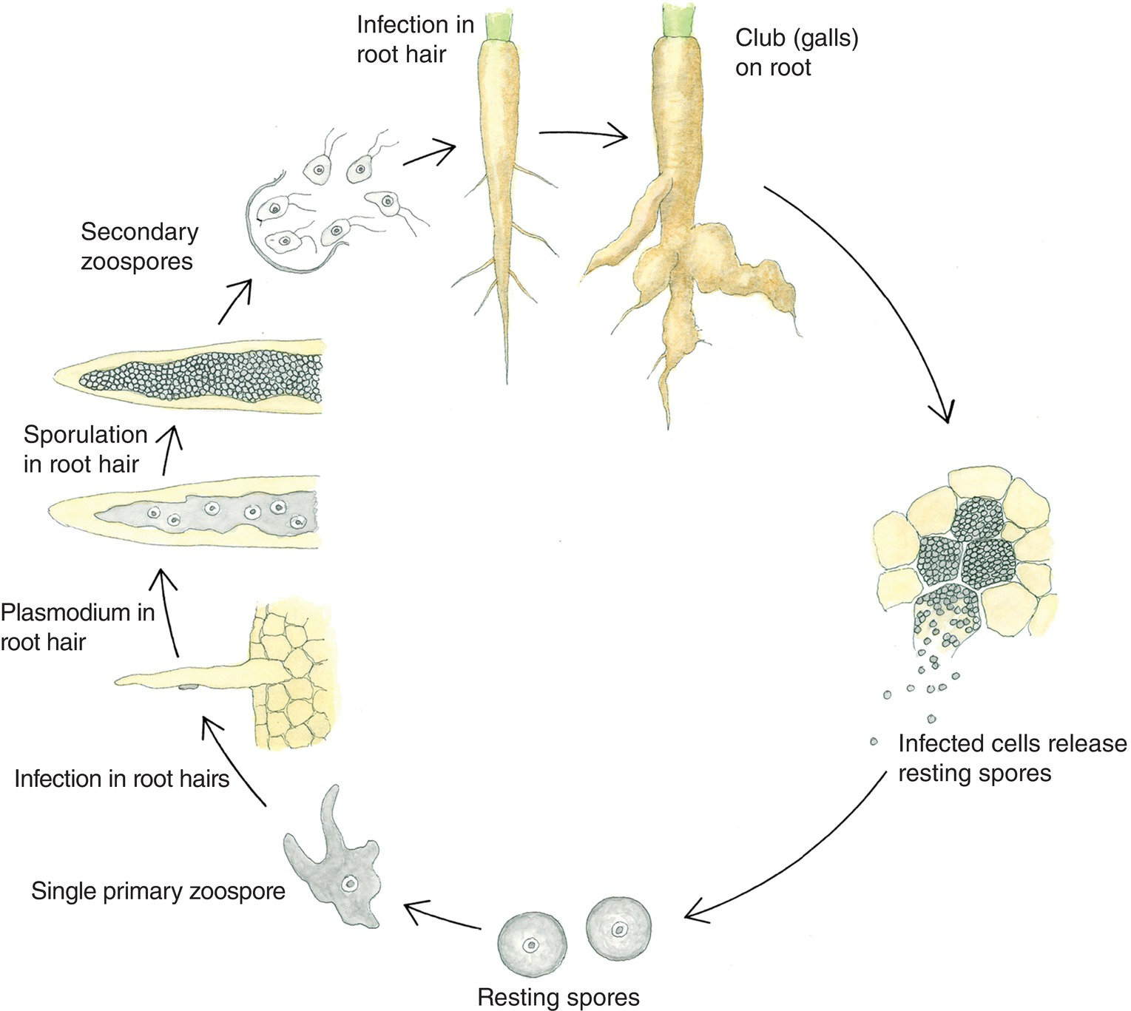
Fig. 5.14 Disease cycle of Plasmodiophora brassicae. (H. Karlsen © NIBIO.)
Plant Pathology and Plant Diseases © Anne Marte Tronsmo, David B. Collinge, Annika Djurle, Lisa Munk, Jonathan Yuen and Arne Tronsmo 2020

Slide 19
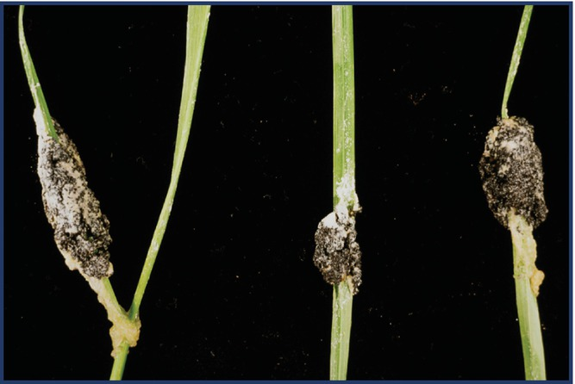
Fig. 5.15 Slime mould on turf grasses. (R. Lagnes © NIBIO.)
Plant Pathology and Plant Diseases © Anne Marte Tronsmo, David B. Collinge, Annika Djurle, Lisa Munk, Jonathan Yuen and Arne Tronsmo 2020

